Slide 1
BASIC
Sepsis and Septic Shock
Dr Corynn Goh

Slide 2
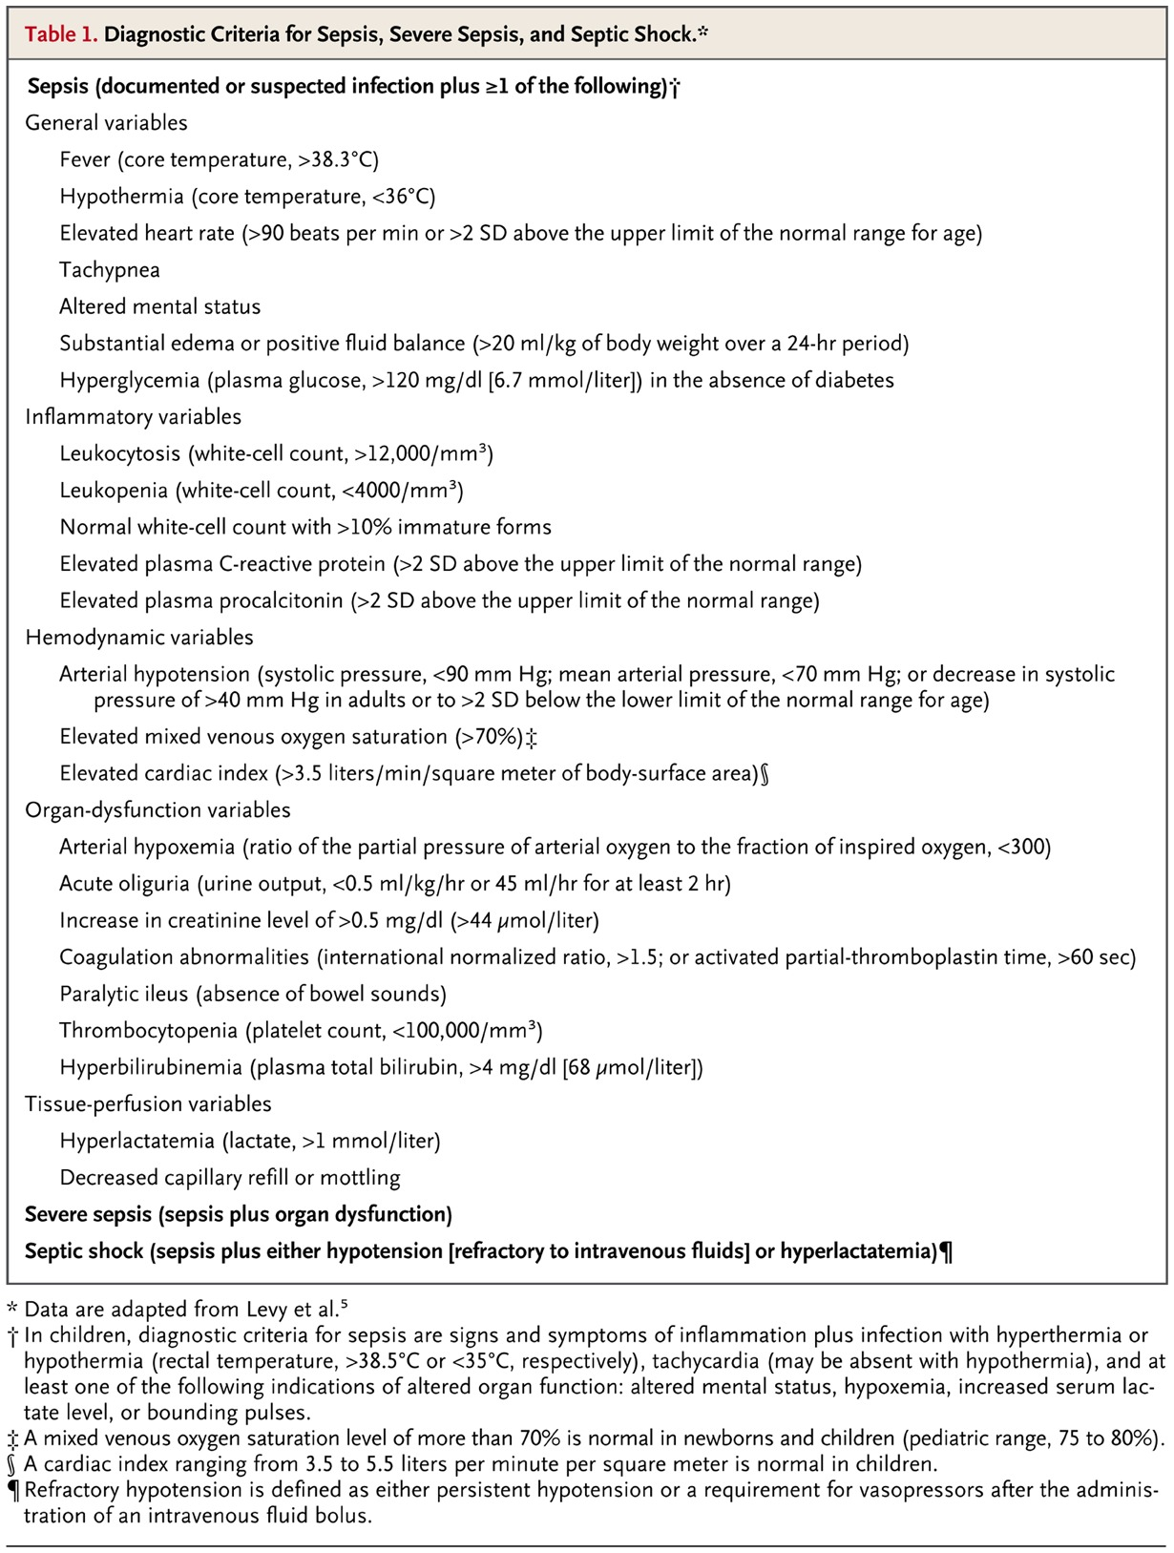
Diagnostic Criteria for Sepsis, Severe Sepsis, and Septic Shock.
Angus DC, van der Poll T. N Engl J Med 2013;369:840-851
Notes:
Table 1 Diagnostic Criteria for Sepsis, Severe Sepsis, and Septic Shock.

Slide 3
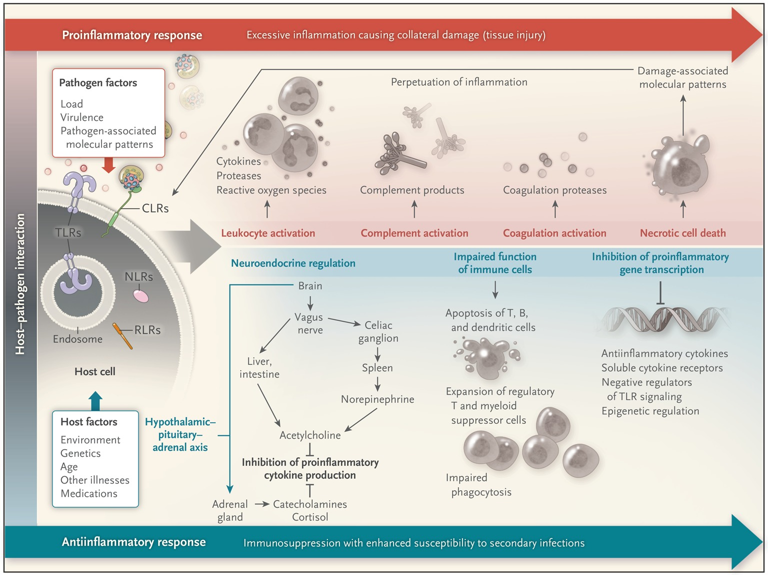
The Host Response in Severe Sepsis.
Angus DC, van der Poll T. N Engl J Med 2013;369:840-851
Notes:
Figure 1 The Host Response in Severe Sepsis. The host response to sepsis is characterized by both proinflammatory responses (top of panel, in red) and antiinflammatory immunosuppressive responses (bottom of panel, in blue). The direction, extent, and duration of these reactions are determined by both host factors (e.g., genetic characteristics, age, coexisting illnesses, and medications) and pathogen factors (e.g., microbial load and virulence). Inflammatory responses are initiated by interaction between pathogen-associated molecular patterns expressed by pathogens and pattern-recognition receptors expressed by host cells at the cell surface (toll-like receptors [TLRs] and C-type lectin receptors [CLRs]), in the endosome (TLRs), or in the cytoplasm (retinoic acid inducible gene 1–like receptors [RLRs] and nucleotide-binding oligomerization domain–like receptors [NLRs]). The consequence of exaggerated inflammation is collateral tissue damage and necrotic cell death, which results in the release of damage-associated molecular patterns, so-called danger molecules that perpetuate inflammation at least in part by acting on the same pattern-recognition receptors that are triggered by pathogens.

Slide 4
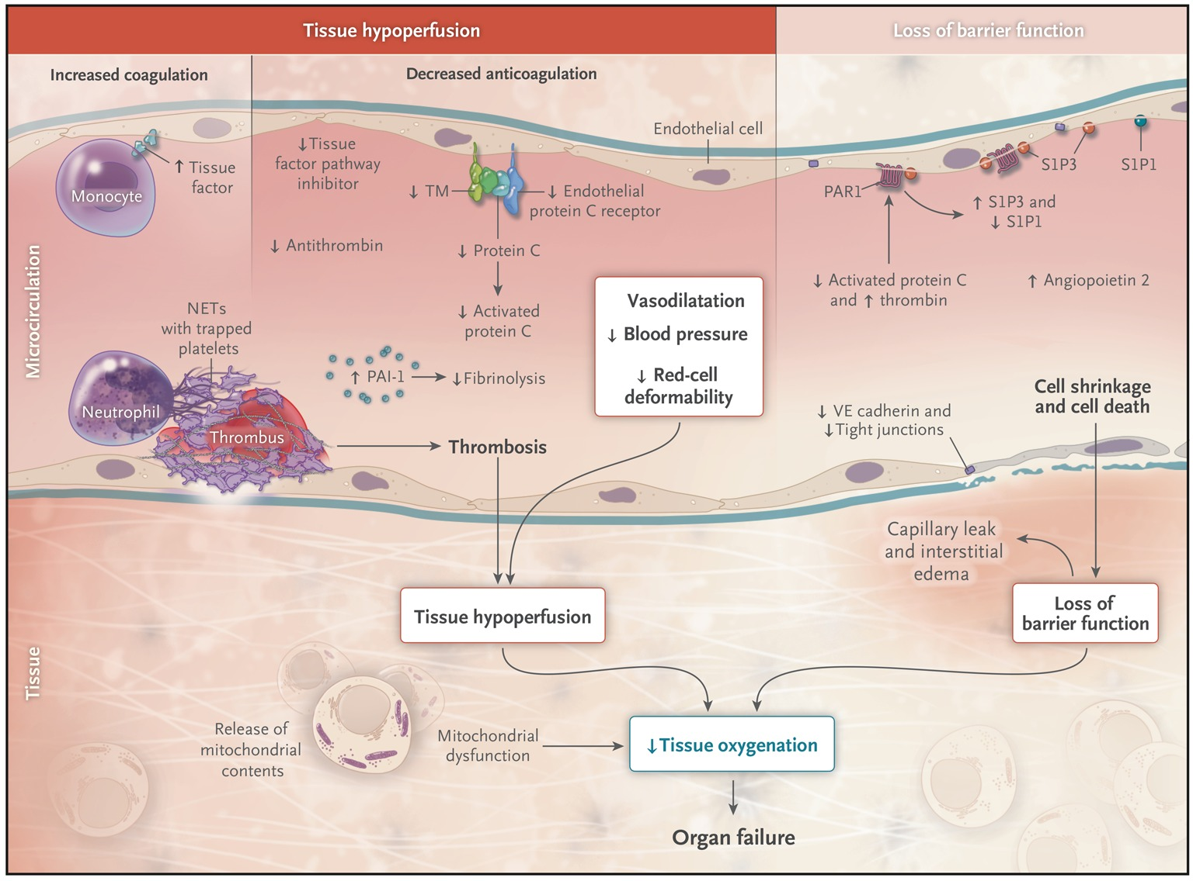
Organ Failure in Severe Sepsis and Dysfunction of the Vascular Endothelium and Mitochondria.
Angus DC, van der Poll T. N Engl J Med 2013;369:840-851
Notes:
Figure 2 Organ Failure in Severe Sepsis and Dysfunction of the Vascular Endothelium and Mitochondria. Sepsis is associated with microvascular thrombosis caused by concurrent activation of coagulation (mediated by tissue factor) and impairment of anticoagulant mechanisms as a consequence of reduced activity of endogenous anticoagulant pathways (mediated by activated protein C, antithrombin, and tissue factor pathway inhibitor), plus impaired fibrinolysis owing to enhanced release of plasminogen activator inhibitor type 1 (PAI-1). The capacity to generate activated protein C is impaired at least in part by reduced expression of two endothelial receptors: thrombomodulin (TM) and the endothelial protein C receptor. Thrombus formation is further facilitated by neutrophil extracellular traps (NETs) released from dying neutrophils. Thrombus formation results in tissue hypoperfusion, which is aggravated by vasodilatation, hypotension, and reduced red-cell deformability. Tissue oxygenation is further impaired by the loss of barrier function of the endothelium owing to a loss of function of vascular endothelial (VE) cadherin, alterations in endothelial cell-to-cell tight junctions, high levels of angiopoietin 2, and a disturbed balance between sphingosine-1 phosphate receptor 1 (S1P1) and S1P3 within the vascular wall, which is at least in part due to preferential induction of S1P3 through protease activated receptor 1 (PAR1) as a result of a reduced ratio of activated protein C to thrombin. Oxygen use is impaired at the subcellular level because of damage to mitochondria from oxidative stress.

Slide 5
Common causes of sepsis in ICU
Organism | Subgroup | prevalence
Gram positive (65%) | Coagulase –ve Staph Staph aureus enterococci | 36% 17% 10%
Gram negative (25%) | E coli Klebsiella sp Pseudomonas aeruginosa Enterobacter Serratia acinetobacter | 4% 4% 5% 5% 2% 2%
Fungi (9%) | Primarily candida Albicans Glabrata Parapsilosis tropicalis | 54% 19% 11% 11%

Slide 6
Clinical signs and symptoms suggestive of sepsis and septic shock
Organ system | Symptoms/signs
Cardiovascular | Hypotension requiring vasopressors Chest pain, pulmonary oedema Cardiac index <2.5, decreased SVRI Tachycardia, increased cardiac output
Respiratory | Cyanosis, tachypnoea, orthopnoea Increased sputum Hypoxaemia(PaO2/FiO2<300) SaO2 <90%
Neurologic | Weakness, confusion, psychosis, seizures, delirium
Renal | UO <0.5ml/hr, abnormal UE, acidosis, increasing base deficit
Hepatic | Abnormal LFTs, abnormal INR, asterixix, encephalopathy

Slide 7
Clinical signs and symptoms suggestive of sepsis and septic shock
Organ System | Symptoms/signs
Immunologic | Hyper/hypothermia High WCC with/without left shift Neutropaenia
Haematologic | Easy bruising, petechaie Spontaneous bleeding Anaemia Raised INR, APTT DIC – low fibrinogen, high D-dimer
GIT | Anorexia, ileus, nausea, vomiting Inability to tolerate NG feeding Low serum albumin
Endocrine | Hyperglycaemia/hypoglycaemia Adrenal insufficiency Catabolism/weight loss
Metabolic | Raised serum lactate

