Slide 1
Basic Care of the Ventilated Patient

Slide 3
Objectives
By the end of this session, you will be able to verbalise:
Equipment Safety
Patient Safety
Patient Comfort
needs required for the ventilated patient

Slide 4
EQUIPMENT SAFETY
Emergency safety checks
Airway drawer
Alarm limits (monitor & ventilator)
Ventilator (humidifier setting, water)
All equipment plugged in, charging
Bedspace clear of clutter
Ensure access to airway, emergency bell

Slide 5
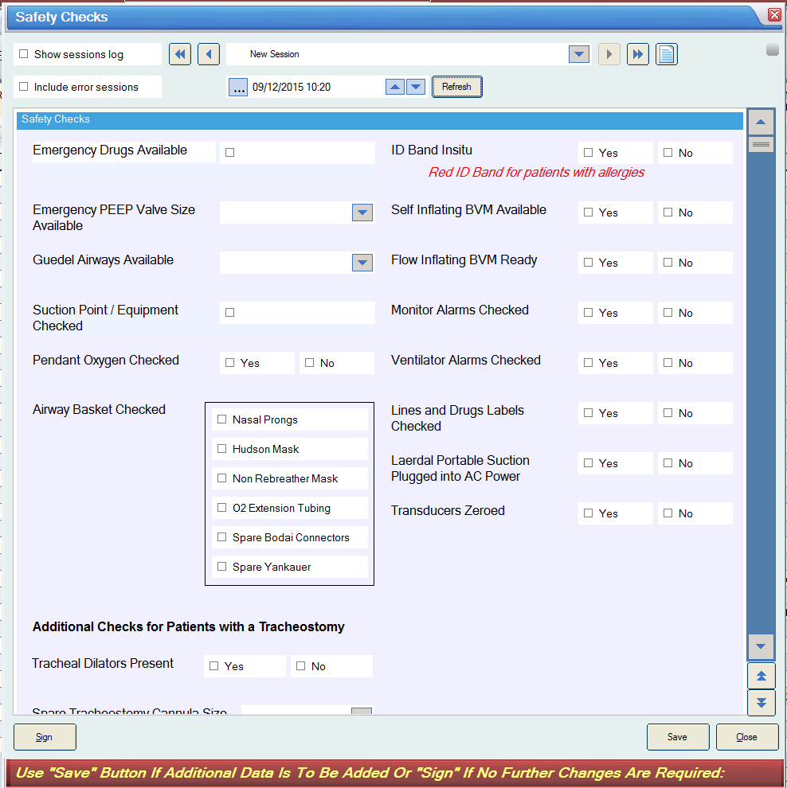

Slide 6
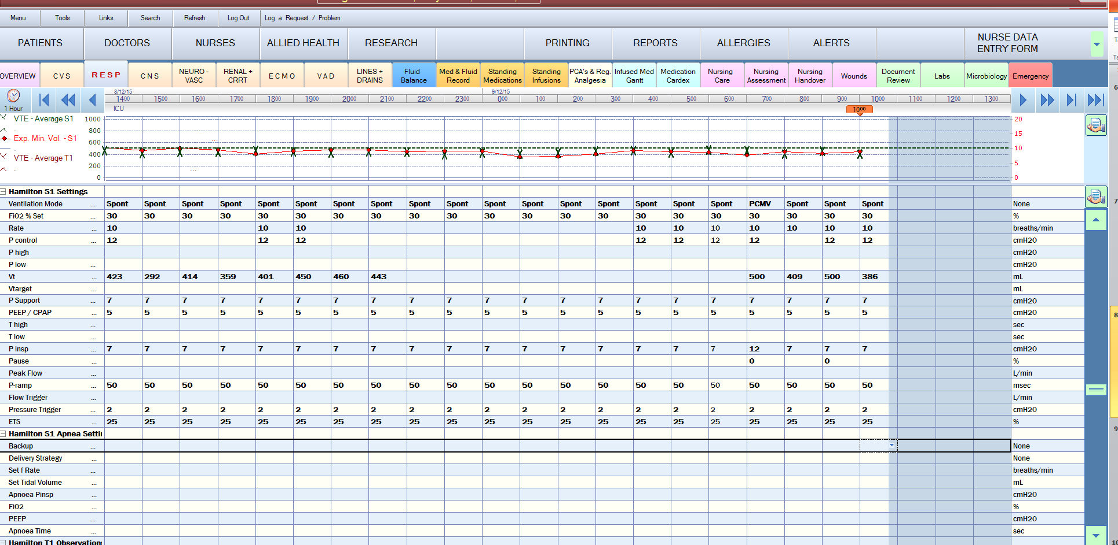
Start of EVERY shift!

Slide 7
PATIENT SAFETY
Continuous observation and monitoring with a 1:1ratio
Systematic and comprehensive assessment

Slide 8
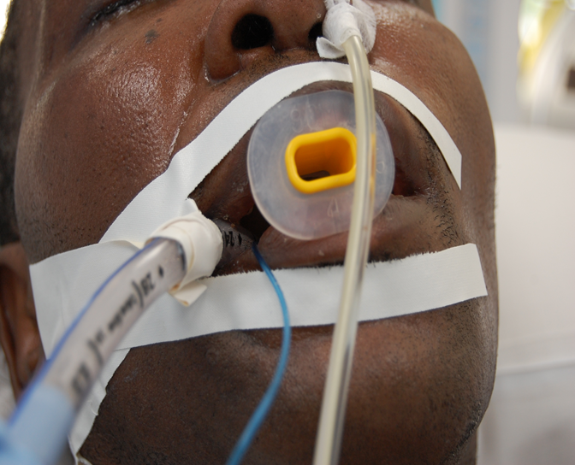
Airway
Airway secure
Size
Length
Position
Cuff pressure
Condition of mouth

Slide 9
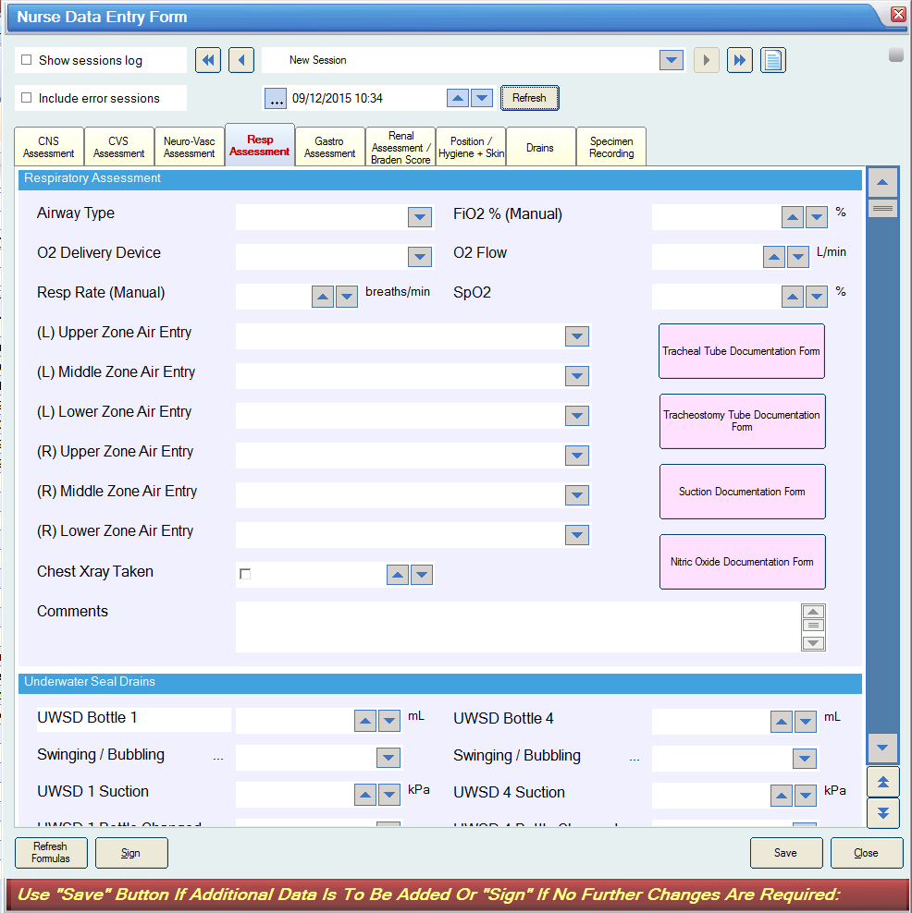

Slide 10
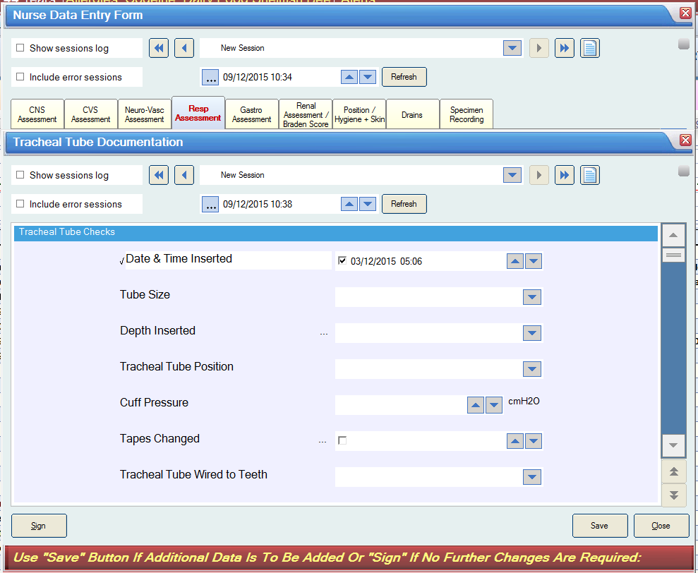

Slide 11
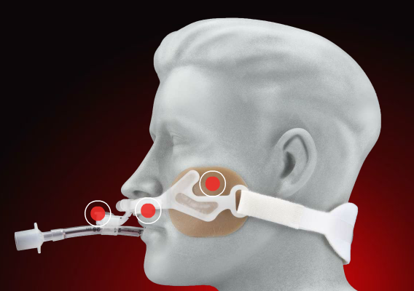
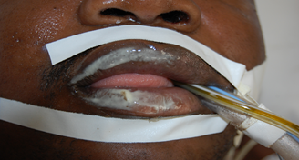
TUBE
Incorrect placement puts patients at significant risk
Auscultation
EtC0₂
Radiological
Security
CUFF
Too High vs Too Low

Slide 12
Secretion Clearance Potentially hazardous activity!
Bleeding
Infection
Atelectasis
Hypoxaemia
CVS instability
Raised ICP

Slide 13
Secretion clearance
Frequency determined by patient need.
Indications for suctioning:
Coughing
Auscultation
Review of secretion production
Spo2, ETCO2
Airway pressures
Tidal Volumes
Prior to suctioning, first assess
Cardiovascular stability
PEEP

Slide 14
Minimising risk of complications
Pre oxygenation
Catheter not more than double of the diameter of the endotracheal tube
Continuous rather than intermittent suction
No longer than 15 seconds
Prevent repeated trauma to the carina
Reduce number of passes
Humidification
Avoid saline lavage

Slide 15
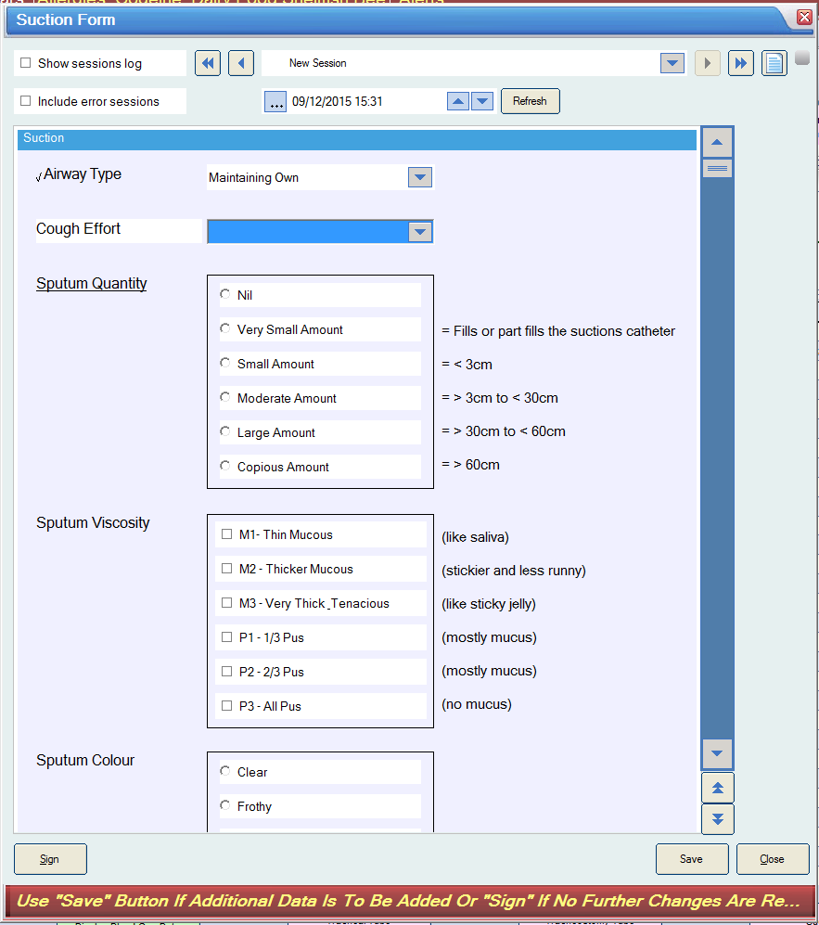

Slide 16
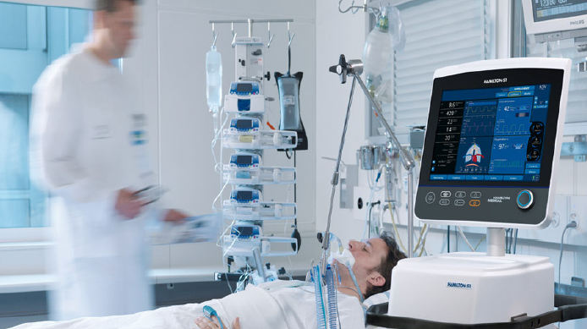
Breathing
Rise and fall
Patient colour
Respiratory Rate
Ventilator settings & observations
Sp0₂
EtC0₂

Slide 17
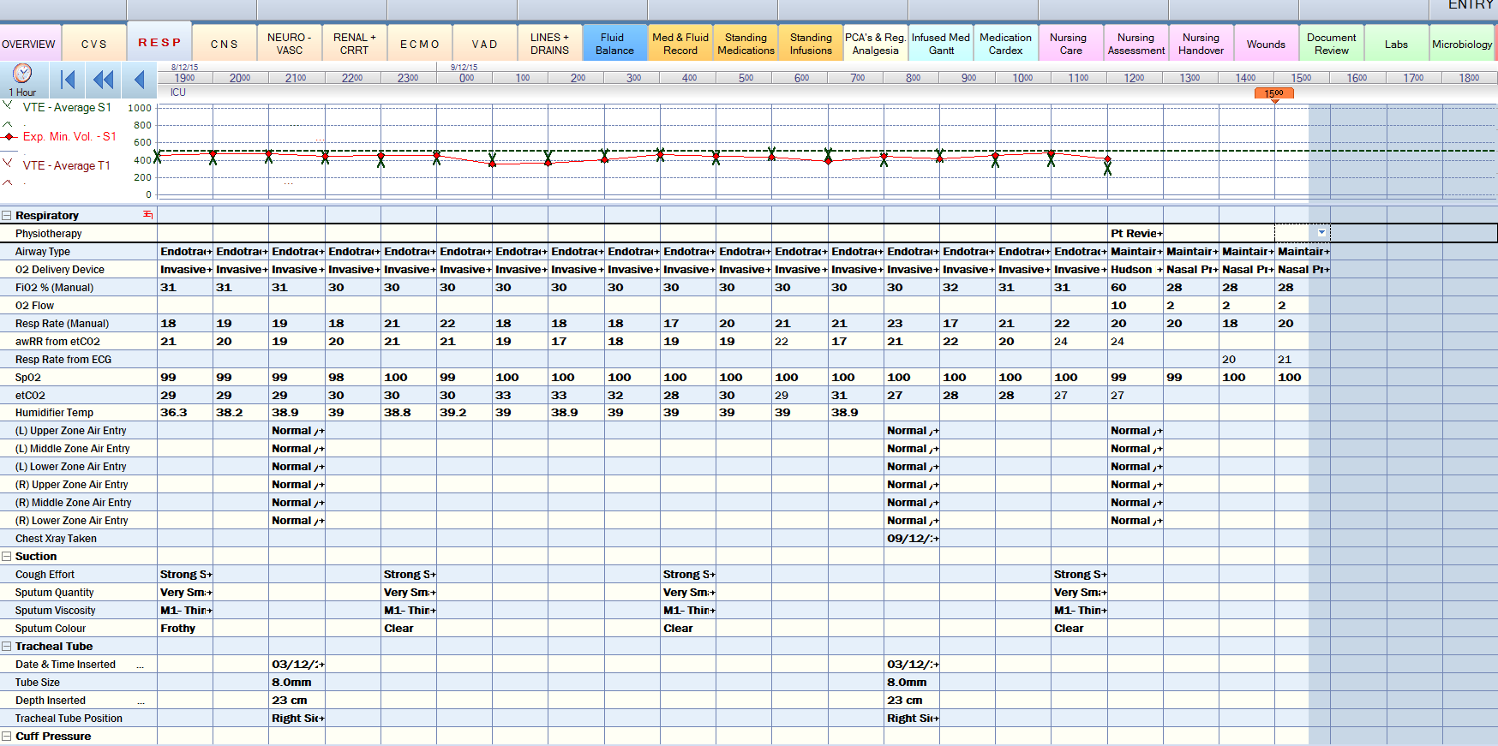

Slide 18
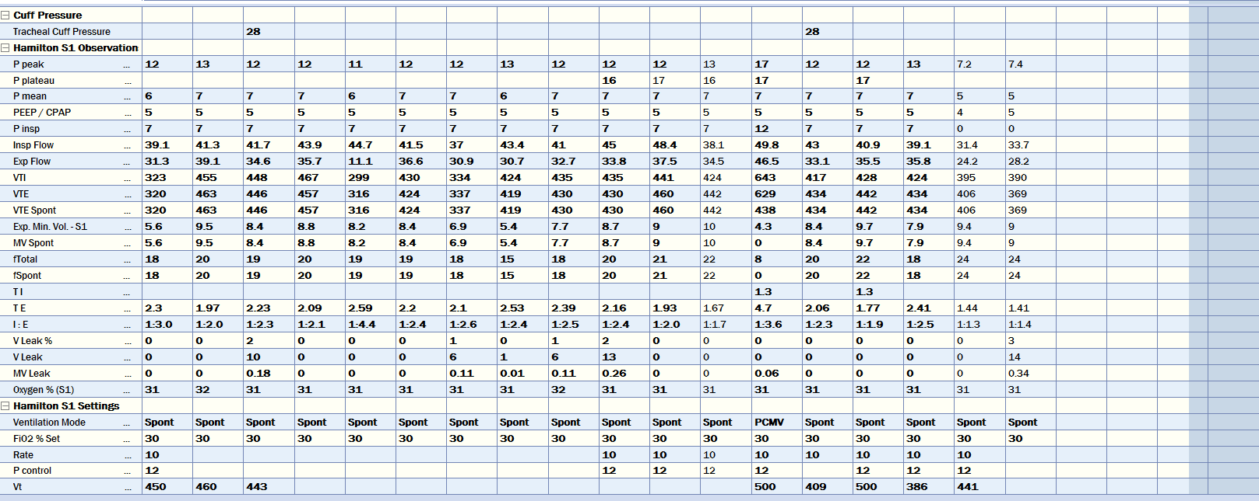

Slide 19
PATIENT COMFORT
Interventions should have a positive impact & assist in the patient’s progression toward desired outcomes
Patient Positioning
Eye care
Oral Care

Slide 20
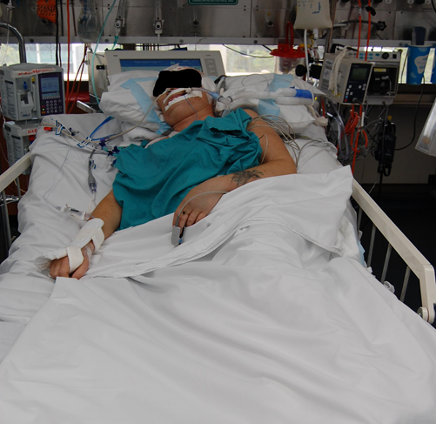
Patient positioning
Position specific to pt goals
Head up 30*
reduce aspiration / VAP
Improve comfort (alignment)
Consider hemodynamic stability, lung pathology
Improves gas exchange
V/Q matching
Decrease WOB
Improves range of motion, muscle strength and function

Slide 21
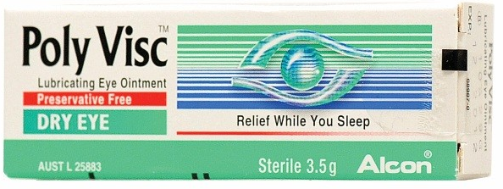
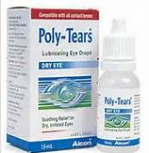
Eye care
ICU patients are a high risk group dependent on eye care to maintain eye integrity.
In sedated patients, there’s a loss of basic eye protective measures, resulting in:
Corneal dehydration
Corneal abrasions
Infections
Individual assessment essential to
determine eye care needs.

Slide 22
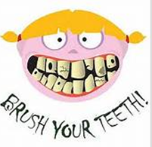
Mouth care
Evidence suggests link between colonization of dental plaque with respiratory pathogens & VAP
Two hourly mouth care
Biotene & swabs
Suction oropharynx
Eight hourly teeth brushing
Cuff
Brush, water lavage via syringe
Suction

Slide 23
General points
Sedation and analgesia
Wash, linen change
Peri & IDC care
Pressure areas
Invasive lines
Relocating probes
Day-night routine
Communication
Patient
Family

Slide 24
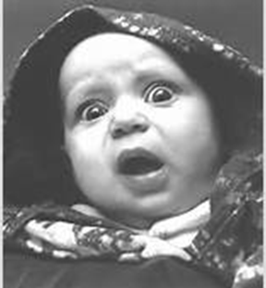
Questions???

