Slide 1
BASIC Mechanical Ventilation

Slide 2
Physics

Slide 3
FLOW = PRESSURE/RESISTANCE
…..PRESSURE = RESISTANCE X FLOW
Alveolar pressure is divided into 2 components
BASELINE PRESSURE and PRESSURE DUE TO INFLATION OF THE LUNGS
ALVEOLAR PRESSURE = PEEP +VOLUME/COMPLIANCE
Airway pressure, flow and tidal volume are all interlinked.
For any given level of PEEP, only 2 of these 3 variables can be altered.

Slide 4
OXYGENATION
THE VENTILATOR CAN BE USED TO INCREASE THE ALVEOLAR PARTIAL PRESSURE OF OXYGEN OR TO REDUCE SHUNTING
Fi02
Mean alveolar pressure (mean airway pressure)
Set tidal volume or inspiratory pressure
Inspiratory time
peep
(alveolar ventilation)
Reopening alveoli with increased peep
Prolonged inspiration
INHALED EPOPROSTENOL OR NITRIC OXIDE

Slide 5
REDUCING CO2
RR
TIDAL VOLUME
Beware barotrauma

Slide 7
Mechanical Ventilation in 1 Slide…
Negative vs. positive pressure
Pressure vs. volume
Mandatory vs. spontaneous
Oxygenation and ventilation
Don’t forget the heart
Safe rules: Pressures <30cmH2O,
Volumes 8ml/kg,
enough O2 but not too much

Slide 8
Goals
Patient – ventilator synchrony
Respiratory rate
Respiratory effort
Patient comfort
Prevent ventilator associated lung injury
Flow curves
Pressure Volume loops

Slide 9
Which Mode?
34 year old 60 kg female
Isolated severe head injury
Paralysed and sedated

Slide 10
Set the ventilator…..
What are the priorities? (34 year old 60 kg female, isolated severe head injury, Paralysed and sedated)
Tv, Rate (f), FiO2, pressure support (cmH2O),PEEP

Slide 11
Volume - Synchronized Intermittent Mandatory
Ventilation ( V - SIMV )
Timing window
Spontaneous Breaths
Trigger
Level
Insp Effort Synchronized
with Delivery of Mandatory Vt

Slide 12
Volume - Synchronized Intermittent Mandatory
Ventilation ( V - SIMV )
Spontaneous Pressure supported Breaths
Mandatory Breath
All Mandatory Breaths Synchronised
to Patients Inspiratory Effort
Unsupported
Spontaneous Breaths

Slide 13
SIMV (Volume control plus pressure support)
Advantages
Synchronisation of both mandatory and spontaneous breaths
Guaranteed minimum minute ventilation
Rests muscles of respiration (if properly set)
Disadvantages
↓ lung compliance ⇒ ↑ alveolar pressure with risk of barotrauma
Risk of inadequate volumes if pressure limiting
Inappropriate triggering may result in excessive minute ventilation
Can still result in excess work of breathing and fatigue.
Notes:
The advantages are its relative simplicity, the tidal volume and minimum ventilatory rate are set, thus guaranteeing a minimum minute ventilation and, if properly set, resting the muscles of respiration.
The disadvantages:
Not synchronized with patient’s breathing - ventilator initiated breath may come on top of a patient initiated breath.
Patient may “lead” ventilator (ie try to suck gas out of the ventilator) if inspiratory flow not high enough
Inappropriate triggering (eg as a result of hiccoughs) may result in excessive minute ventilation
Fall in lung compliance results in high alveolar pressure with risk of barotrauma
Often requires sedation to achieve synchrony.

Slide 14
Initial ABG
Any Changes?
pH | 7.31
P_{a}CO₂ | 50 mmHg
P_{a}O₂ | 412 mmHg
HCO₃⁻ | 24
Base excess | +1
Saturation | 100%
Notes:
High PO2 – decrease FiO2
Respiratory acidosis – need to increase alveolar ventilation. Choices are to increase respiratory rate or increase tidal volume or both

Slide 15
SIMV Summary
Common mode in ICU
Almost invariable for patients returning from theatre
Good for straightforward cases
Bad weaning mode
Bad if problem is oxygenation or poor compliance

Slide 16
Now which mode?
ICP controlled
Sedation and paralysis stopped
Patient starts to wake up
Dysynchrony with breath stacking
Notes:
The patient improves, the sedation and paralysis is stopped and she start to wake. As she wakes up patient-ventilator dysynchrony develops with breath stacking

Slide 17
PRESSURE SUPPORT
Vt 500mls
Spontaneous Breath + Pressure Support
Increase in Vt Size
Vt 200mls
Unsupported Spontaneous Breath
Vt Size
Spontaneous Insp
Trigger

Slide 18
Pressure Support Mode
Primarily a weaning mode
Patient is required to trigger all breaths
Only pressure level is set
All other parameters controlled by patient
Expiration is time cycled
Theoretically more comfortable

Slide 19
PSV

Slide 20
Set the ventilator
PEEP, Psp, FiO2
ABG
pH 7.35
pCO2 34
pO2 80
HCO3 24
Sats 94%
Happy?
Always assess the patient
Notes:
The patient improves, the sedation and paralysis is stopped and she start to wake. As she wakes up patient-ventilator dysynchrony develops with breath stacking

Slide 21
Pressure support
Advantages
Simple to set
Avoids high inspiratory pressures
Better patient-ventilator synchrony
Unloads respiratory muscles
Improved gas flow distribution
Disadvantages
No apnoea back-up in older ventilators
Change in lung compliance or resistance ⇒ change in tidal volume
Excessive work of breathing

Slide 22
Bilevel (Bipap or Duopap) Ventilation
Used to Improve oxygenation or maximise ventilation when compliance is poor.

Slide 23
BILEVEL VENTILATION
25
20
15
PRESSURE
10
5
FLOW
INSP
INSP
EXP
EXP

Slide 24
Bilevel Ventilation
Advantages
Reduces risk of barotrauma
Improved recruitment of long time constant alveoli
Patient-ventilator synchrony
Disadvantages
Overventilation if compliance improves
Risk of Volutrauma
Small tidal volumes if pressures are high

Slide 25
Other settings
Trigger sensitivity
↑ sensitivity preferable
Flow triggering general more sensitive than pressure triggering
↓ flow or ↓ pressure ⇒ ↑ sensitivity
I:E ratio
Notes:
The trigger sensitivity determines how easy it is for the patient to trigger the ventilator to deliver a breath. In general increased sensitivity is preferable in order to improve patient-ventilator synchrony (ie to stop the patient "fighting" the ventilator) but excessively high sensitivity may result in false or auto-triggering (ie ventilator detects what it "thinks" is an attempt by the patient to breath even when the patient is not). Triggering may be flow-triggered or pressure triggered. Flow triggering is generally more sensitive. The smaller the flow or the smaller the negative pressure the more sensitive the trigger

Slide 26
Other Modes
Assist Control
Characteristics of each inspiration are the same
Not affected by whether breath is control breath or an assist breath
CPAP
PEEP with no pressure support
APRV
Rescue mode for severe ARDS
Notes:
In assist control mode the tidal volume is set. Breaths can either be initiated by the ventilator (control breaths) or by the patient (assist breaths). However, the same tidal volume is delivered in the same time regardless of whether the breath is

Slide 27
High airway pressure
Pressure alarm limit
Pressure
70 l/min
Flow
-70
700 ml
Volume
Notes:
With most ventilators the ventilator inspiration is terminated if the airway pressure reaches the set upper pressure limit. As this usually occurs relatively early in inspiration this results in the patient receiving a much lower tidal volume. This is illustrated on this slide. The first 2 breaths are normal volume control breaths [paw03]
On the subsequent breaths the airway pressure reaches the pressure alarm limit causing the ventilator to terminate inspiration with a resultant fall in airway pressure [paw04] and reduction in tidal volume. [paw05]

Slide 28
High airway pressure
Significance
Barotrauma
Change in patient’s condition
Inadequate ventilation
Notes:
High airway pressure is an important problem because of the risk of barotrauma, because the development of high airway pressure indicates a deterioration in the patient’s condition and because it may lead to inadequate ventilation [paw02]

Slide 29
Assess
Chest movement
Breath sounds
Respiratory rate
Haemodynamic effects
Oximetry
Blood gases

Slide 30
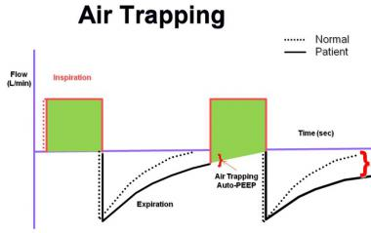
Gas Trapping

Slide 31
Patient ventilator asynchrony

Slide 32
Man or machine?
Notes:
This is most easily determined by disconnecting the patient from the ventilator and manually ventilating him or her. If the problem persists it is a patient or ET tube problem; if it is eliminated it is a ventilator or circuit problem.[urgency04]

Slide 33
Physics
A (P_{AW})
B (P_{ALV})
Volume/compliance +PEEP
Flow x resistance
Notes:
The airway pressure is determined by flow, volume and PEEP as well as the lung compliance and resistance.

Slide 34
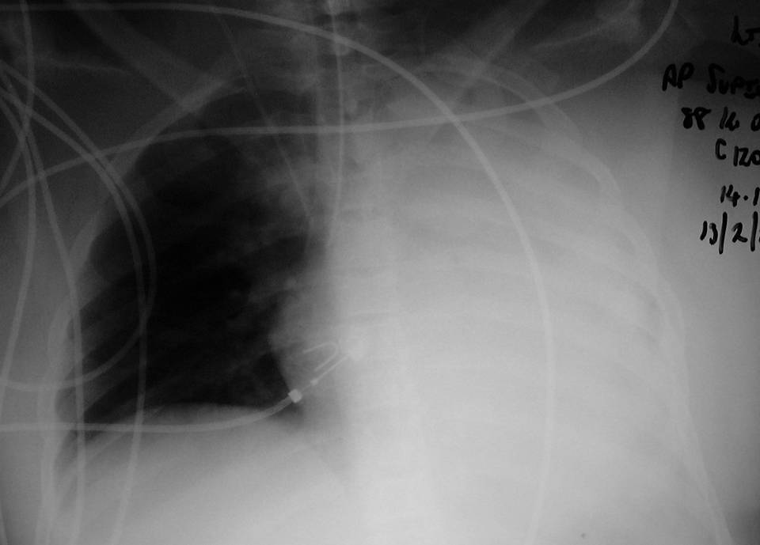
Notes:
or an endobronchial intubation [paw20]

Slide 35
Questions?

