Slide 1
Haemodynamic Monitoring

Slide 3
Objectives
Discuss the indications for use of IHM
Describe the insertion sites and techniques
Identify the complications associated with IHM
Interpret IHM pressure waveforms
Describe the nursing care for patients with IHM

Slide 4
Types of Haemodynamic Monitoring
Non-invasive
ECG
Blood Pressure (BP)
Pulse Oximetry
Urine Output
Invasive
Central Venous Catheter
Arterial Catheter
Pulmonary Artery Catheter (Swan Ganz)

Slide 5
Invasive Measures
Central Venous | Arterial | Pulmonary Artery PA pressure and PAWP/PCWP
Central Venous Pressure | Systolic, diastolic and MAP | Pressures of pulmonary artery, and left side of heart

Slide 6
Arterial Monitoring Indications
Haemodynamic instability
Vasoactive therapy
Acute hypo/hypertensive crisis
Intra and post major surgery
Frequent blood gas samples

Slide 7
Arterial Measurements
Systolic/Diastolic BP
Mean Arterial Pressure (MAP)
Average pressure within arterial system
MAP = systolic + (Diastolic x2)
3
Average MAP 70-90

Slide 8
Contraindications
Infection
Haemorrhage
Arterial embolization
Vascular insufficiency

Slide 9
Allen’s test

Slide 10
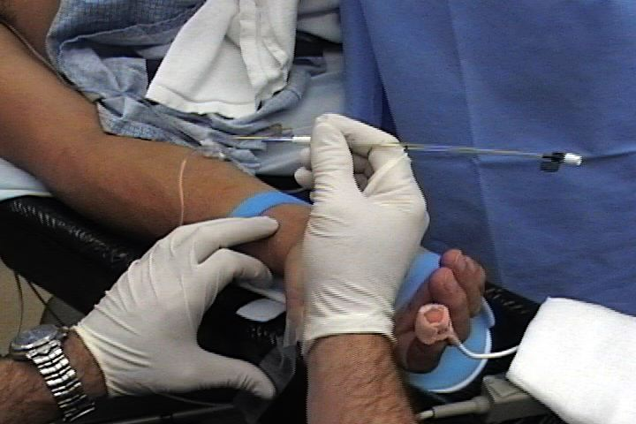
Radial insertion

Slide 11
Monitoring System Components

Slide 12
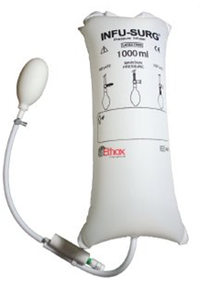
Accurate arterial pressure measurement
Pressure bag inflated to 300mmHG
Transducer position – phlebostatic axis
Zeroing the transducer
Correlate to other BP measurements

Slide 13
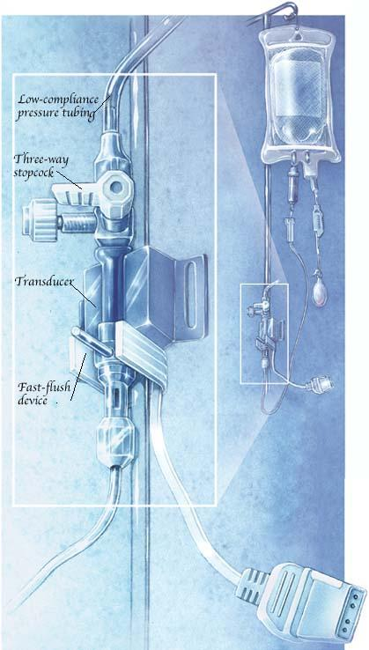
Phlebostatic Axis – 4th intercostal space, midaxilla.

Slide 14
Ensuring Accuracy
ZEROING’
Eliminates atmospheric influence on pressure readings
Open transducer to air and “zero”

Slide 15
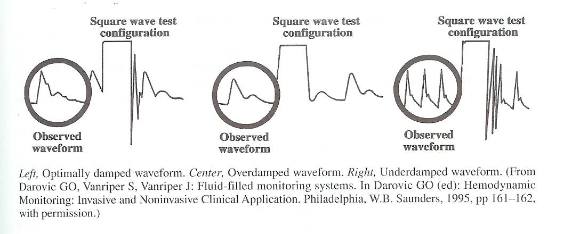
Square Wave Testing

Slide 16
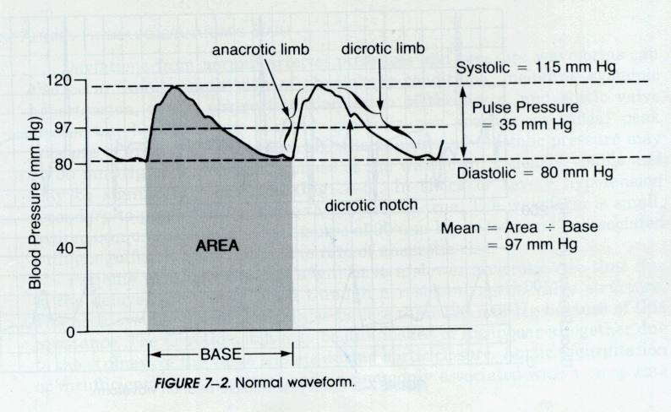
Interpreting the Arterial Waveform
Notes:
Systole goes from end of diastole, until diacrotic notch
Top of the wave form = peak to systolic pressure (L vent contraction)
On downward stroke, the notch (diacrotic)= closure of aortic valve (retrograde bld flow). This is the point were systole finishes and diastole starts.
End distolic pressure is the lowest point = opening of aortic valve.
Pulse pressure- the difference between your systolic and diastolic blood pressure measurements. A very large pulse pressure indicates higher risk for heart problem
Diacrotic notch should be 1/3 or greater of the height of systolic peak otherwise suspect reduced cardiac output.

Slide 17
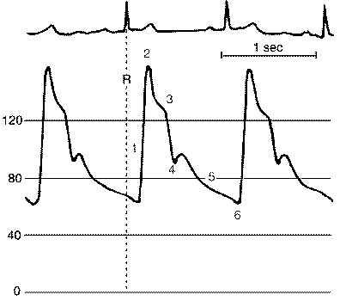
Notes:
Normal arterial wave form in relation to ECG

Slide 18
Notes:
Can learn alot from arterial trace - amount of perfusion ectopics produce compared to normal SR conducted beats
- affect AF is having on perfusion
- is your ECG trace actually PEA (ie. Do you actually have an output?!)
- do you have mechanical capture as well as electrical capture (re: testing pacing)
- VAD has no waveform – just MAP reading as non pulsatile blood flow.

Slide 19
Mechanical Problems
Over-dampening
Under-dampened
No Waveform

Slide 20
Mechanical Problems

Slide 21
Dampening
Air bubbles
Thrombus
Catheter on vessel wall
Catheter kinked/knotted
Loose connection
Incorrect calibration

Slide 22
No Waveform
Leak in system
Loose/cracked transducer
Air in transducer
Stopcock wrong way
Lumen clotted
Pressure in bag low
Defective transducer

Slide 23
Nursing Care
Monitor neurovascular status
Maintain aseptic technique
Prevent complications

Slide 24
Neurovascular Status
NV assessment of distal limb hourly
Splint / support / suture to prevent arterial spasm / thrombosis / haematoma
Flush tubing after taking blood
Assess for nerve damage

Slide 25
Aseptic Technique
Wash hands
Aseptic technique
Change IV transducer set every 72 hours
Redress 3rd daily and prn
Inform MO if been insitu for 7 days

Slide 26
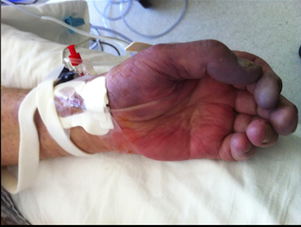
Complications
Vascular thrombosis
Embolism
Vascular spasm
Necrosis at site
Peripheral ischemia
Haemorrhage
Anemia
Blood test errors
Local infection
Systemic infection
Nerve damage
Inadvertent drug administration
Notes:
Picture of inadvertent drug administration https://seattleclouds.com/myapplications/dukeg/ican/ArtLine.html

Slide 27
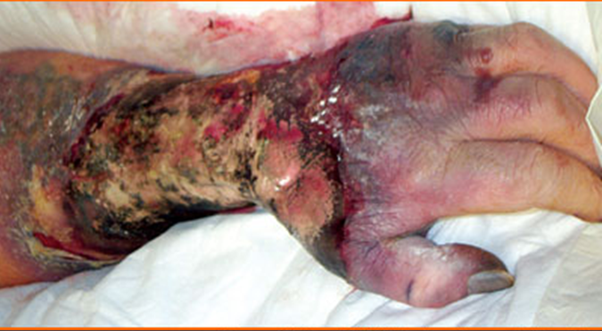
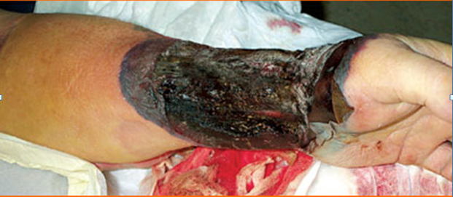
Notes:
Necrosis process from infection and microemboli – actual patient
Top pic is debrided wound.

Slide 28
Prevent Complications
Ensure correct line labelling
Cannula secure
Line visible
Connections secure
Monitor neurovascular status and record phlebitis score
Red cap over access port

Slide 29
Central Venous Pressure (CVP)
Also known as right atrial pressure (RAP)

Slide 30
CVL Insertion Primary Indications
To monitor volume status
Guide administration of fluids and electrolytes
To monitor right ventricular function
Parenteral nutrition
Drug Therapy
Lack of accessible peripheral veins

Slide 31
CVP Monitoring
Direct measurement of the pressure of the right atrium
Measured from the superior or inferior vena cava as there are no valves
Represents the volume of blood within the RA
It can be measured continuously via a pressure transducer or intermittently via a water manometer

Slide 32
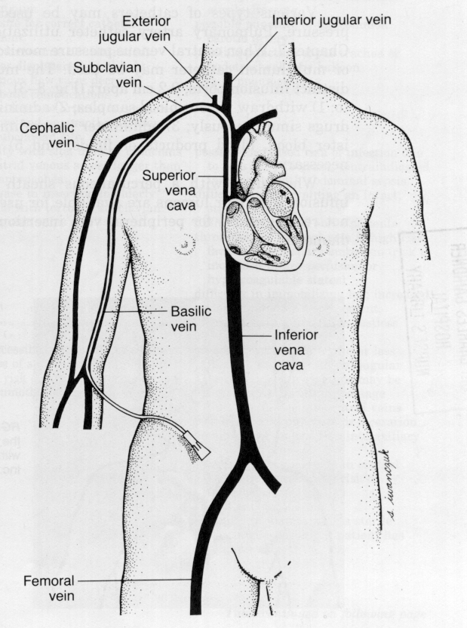
Central Venous Pressure Monitoring
Tip of the catheter is positioned in a central vein, usually the superior vena cava
Reflects right sided heart function
Notes:
CVP is the pressure of the blood emptying into the right ventricle during diastole
Directly measures the pressure in the superior vena cava = CVP
The superior vena cava openly communicates with the right atrium and measure RAP.
Preload for the R) ventricle

Slide 33
CVP Monitoring
CVP measurement is read from the distal lumen of CVC
Normal 0-8 mmHg (3-11cm H₂0)
Notes:
Position of CVP monitoring – emphasise brown lumen (show positioning via flushing – can also show reason not to use smaller syringes)
Monitoring should be attached to 3wt with hydration for emergency access.

Slide 34
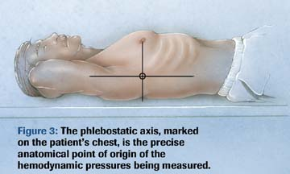
Obtaining CVP Measurement
Position pt supine or HOB up to 30 degrees
Move transducer to the phlebostatic axis. What is the significance of this landmark?
Check patency of intravenous line prior to pressure measurement by flushing line.
Zero transducer to atmospheric pressure.
Notes:
If using water manometer - Level water manometer to.
Mark this point on the pt’s skin to ensure consistency in technique from shift to shift.

Slide 35
Normal CVP wave form
Notes:
The CVP reading is taken at the last half of the A wave at the midpoint of the X descent
Explain graph by starting at v wave and working through; atrial filling, tricuspud valve open, atrial kick (30% CO), atrial relaxation, bulging of tricuspid valve during ventricular systole.

Slide 36
Causes of Low CVP
Hypovolaemia
Profound vasodilation
Any other condition that reduces venous return to the heart

Slide 37
Causes of High CVP
Intra-vascular volume overload
Right ventricular failure
Anything that increases pre-load or
after-load
Decreased contractility

Slide 38
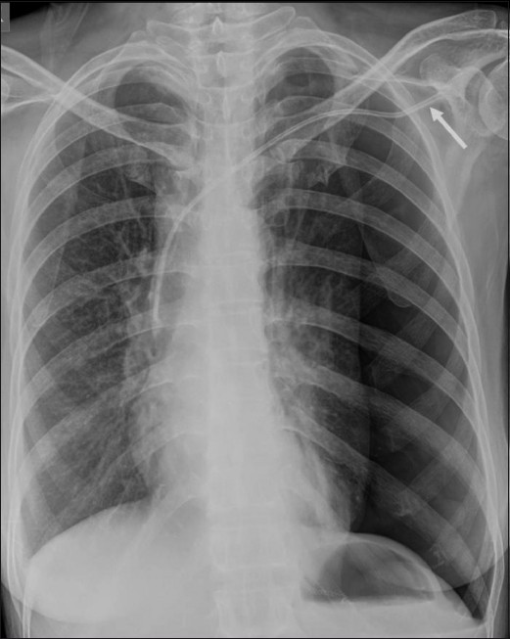
Complications of insertion
Notes:
Frontal chest radiograph shows a left-sided pneumothorax following insertion of a central venous catheter. Note that the subclavian approach (arrow) was used for insertion of the catheter

Slide 39
Central Venous Complications
IMMEDIATE
Bleeding
Arterial puncture
Arrhythmia
Air embolism
Catheter malposition
Pneumothorax or haemothorax
DELAYED
Infection
Venous thrombosis, pulmonary emboli
Catheter migration
Catheter embolization
Myocardial perforation
Nerve Injury

Slide 40
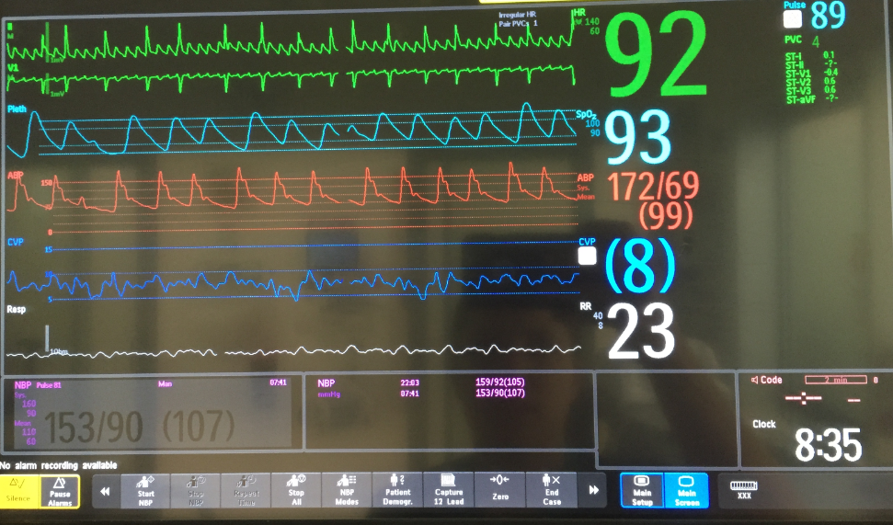
Haemodynamic Monitor
Notes:
Art – systolic is highest measurement after QRS
CVP – lowest point just after QRS (systole) and

Slide 41
Key points for accurate measurements
Levelling to Phlebostatic Axis
Positioning of Transducer
Zeroing with every change of patient position

Slide 42
Decision Making
Therapeutic judgements & decisions are best based on monitoring & clinically observed changes over time…& not an isolated measurement
Look at clinical picture of patient!!

Slide 43
Questions

Slide 44
Summary
Invasive pressure monitoring provides a accurate measurement of a patient’s haemodynamic status
We need to remain aware of potential complications and assess our patient regularly

