Slide 1
COVID-19 FSH ICU INTUBATION GUIDE
 | Doctor 1 AIRWAY | Doctor 2 TEAM LEADER/DRUGS | Bedside Nurse AIRWAY ASSISTANT | Senior Nurse RUNNER
1 | ☐ Confirm Airway Plan | ☐ Prepare Drugs: RSI and emergency ☐ Confirm communication plan with runner | ☐ Prepare COVID Intubation Tray ☐ Prepare sedation drugs | ☐ Runner equipment present/ available ☐ Obtain 2x Clean trolleys for patient room ☐ Control entry/exit
2 | ☐ DON PPE ☐ BUDDY CHECK REMAIN OUTSIDE
3 | ☐ Airway assessment ☐ Optimise patient position ☐ Pre-program ventilator ☐ Check circuit filter order correct | ☐ Ensure working IV Access ☐ Fluid attached and running | ☐ Monitoring check, including etCO2 ☐ Check suction ☐ Check CMAC screen & blade | Liaise with Doctor 2 Place one clean trolley just inside patient room Provide additional kit if required (Resus Trolley/Line Insertion Kit) Assist with donning and doffing
4 | Pre O2: Mapleson with HME for 5 min Aim 6l/min – 8l/min oxygen flow | ☐ Airway and drug plans reconfirmed
5 | Avoid mask ventilation, unless rescue oxygenation (Use 2 hand technique plus guedel) | Rapid Sequence Induction
6 | Do not ventilate until cuff up Use IGEL, if failed intubation | Confirm tube placement | Inflate cuff immediately with 10 ml Secure ETT with Tapes/Ties
7 | NGT insertion |  | Check cuff pressure
8 | Dispose outer set of gloves after instrumenting airway
9 | Insert Lines as required
10 | No other staff to enter for 30 mins
11 | Dispose single use equipment in Clinical waste bin. Bag non-disposable equipment for collection Doff PPE (with Buddy) in patient room, except N95 mask
INTUBATE EARLY. REDUCE STAFF EXPOSURE. REDUCE KIT CONTAMINATION. REDUCE AEROSOL GENERATION. MAXIMISE 1ST PASS INTUBATION

Slide 2
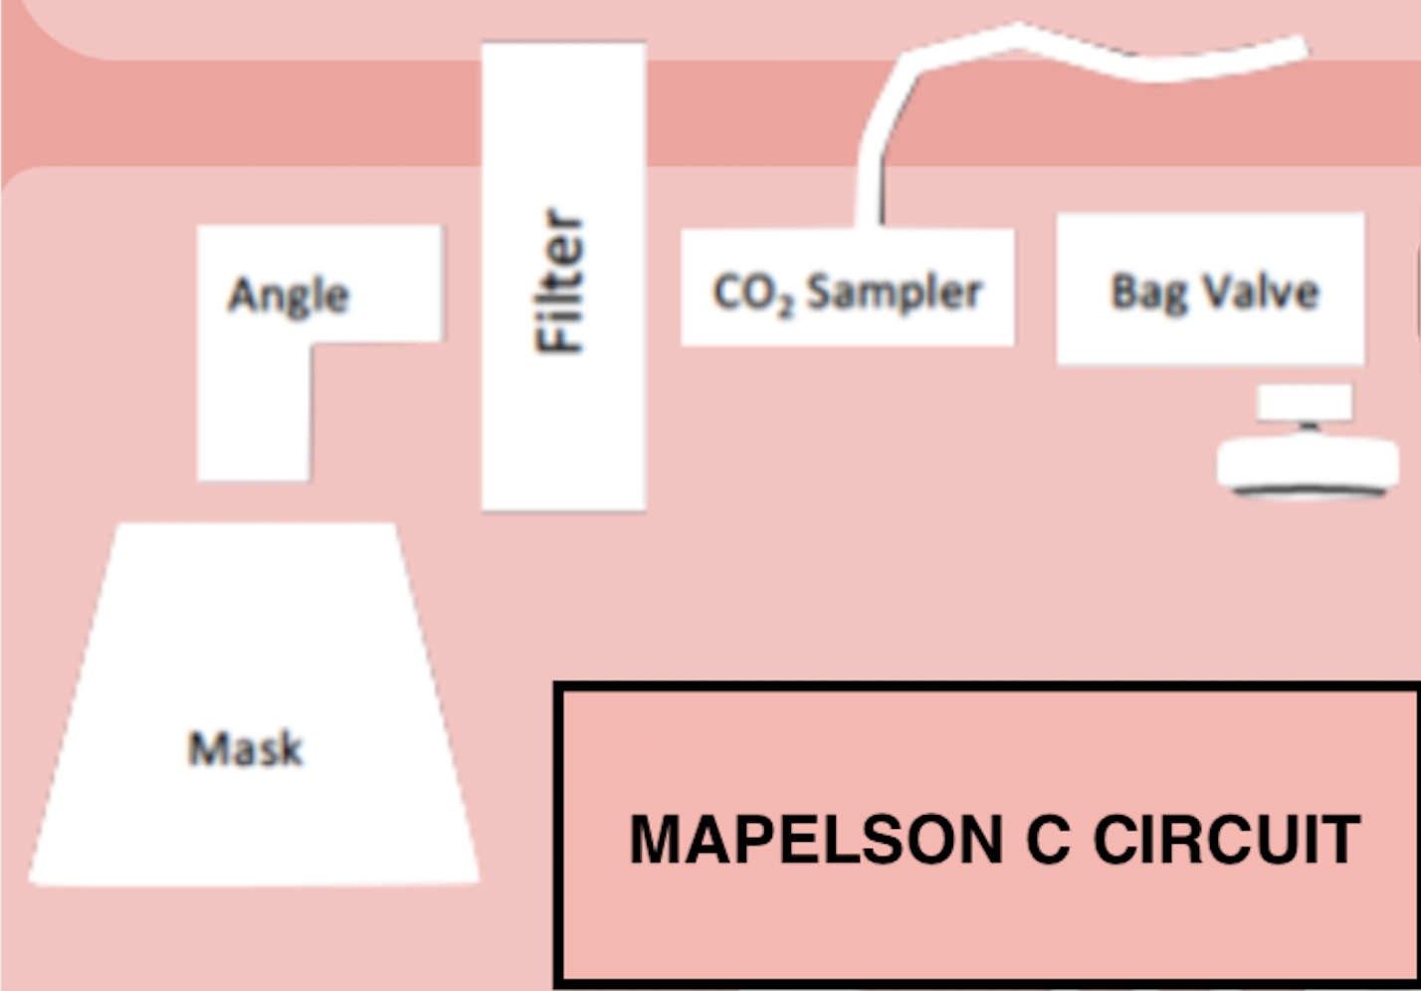
FSH ICU COVID INTUBATION TRAY ❐ CMAC SCREEN + BLADE ❐ BOUGIE ❐ VIRAL FILTER (#3 FEMALE #4 MALE/OBESE PT) ❐ 10 ML SYRINGE ❐ IN-LINE SUCTION ❐ IGEL #4 ❐ GUEDEL (2 SIZES) ❐ NG TUBE 14FR ❐ ETT WITH SUPRAGLOTTIC PORT ❐ LUBRICANT SACHET ❐ MAGILLS FORCEPS (#7/8 FEMALE #8/9 MALE) ❐ TUBE TAPE/TIE ❐ TUBE CLAMP
DRUGS LIST
Fentanyl 500mcg in 10 ml
Propofol 200mg in 20ml
Ketamine 200mg in 20ml
Midazolam 10mg in 10ml
Suxamethonium 200mg in 4 ml
Rocuronium 200mg in 20ml
Metaraminol 10mg in 20ml
2x 0.9% Saline Flush 20mls (from bedspace)
500ml Gelofusin in pump giving set (from bedspace)
Sedation infusions (Propofol/Fentanyl)
CIRCUIT FILTER SEQUENCE

