Slide 1
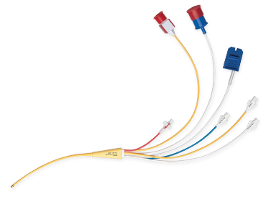
PULMONARY ARTERY CATHETERS Leonie Stojmenov A/CN ICU

Slide 2
OBJECTIVES
Overview
Indications and Contraindications
Complications
Types
Insertion
Pressure Waveforms
Cardiac Output
Continuous Cardiac Output Monitoring
Sv02

Slide 3
OVERVIEW
Right ventricular function
Pulmonary Vascular status
Systemic Vascular status
Indirect Left Ventricular function
Cardiac Output
Aka Swan-Ganz Catheters

Slide 4
INDICATIONS
Cardiac Output measurement
Right and Left heart failure
ARDS
Guide therapies
Vasopressors, inotropes, fluids and diuretics
Complex haemodynamic instability
Obstructive, Distributive, Cardiogenic or Hypovolemic shock

Slide 5
CONTRAINDICATIONS
Tricuspid or pulmonary valve prosthesis
Tricuspid or pulmonary valve vegetations
Endocarditis
Relative contraindication - LBBB

Slide 6
COMPLICATIONS
Complications of CVC insertion
Pneumothorax
Infection
Bleeding
Thrombus
Air emboli
Ventricular Dysrhythmias
Pulmonary Artery Rupture
Balloon Rupture
Catheter knotting

Slide 7
TYPES
Swan Ganz
Swan Ganz CCO
Swan Ganz CCO Sv02

Slide 8
LUMENS
Proximal Injectate Port = Blue
CVP monitoring
Proximal Infusion Port = White
Drugs/Infusions
PA Distal Port = Yellow
PA pressure monitoring
Balloon Lumen = Red
Thermistor connector = White/Red Cap
Electrical Element supply = White/Red Cap
Sv02 = White/Dark Blue connection

Slide 10
INSERTION
Venous sheath insertion
Prime PA intraflow
Waveform monitoring
Attaining Pulmonary Artery Wedge Pressure (PAWP)
Alarm Limits
Securing
CXR

Slide 11
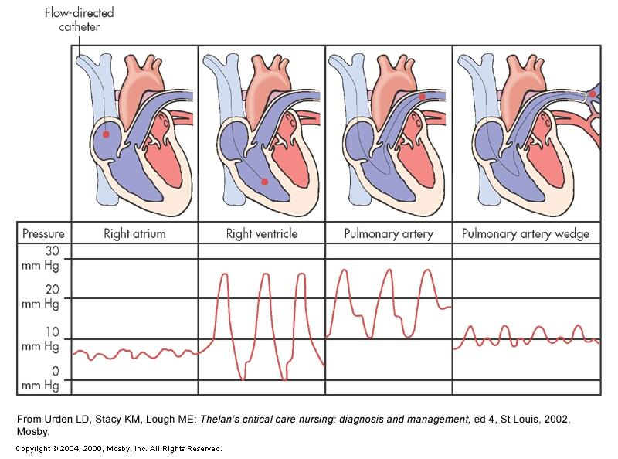

Slide 12
NORMAL VALUES
CVP = 2-8mmHg
RV Pressure
Systolic 20-30mmHg
Diastolic 0-8mmHg
PASP = 20-30mmHg
PADP = 8-12mmHg
PAWP = 8=12mmHg

Slide 13
PERFORMING A WEDGE
Is it safe/necessary?
How often?
Main Setup -> Wedge
Ready for Balloon Inflation
Wedging
Ready for Balloon Deflation
Edit Wedge
Adjust Cursor – ventilated or spontaneous breathing?
Store Wedge

Slide 14
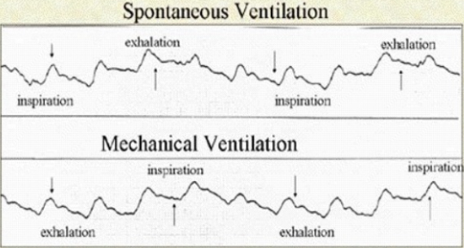
VENTILATED OR SPONTANEOUS?

Slide 15
CARDIAC OUTPUT or CARDIAC INDEX?
CO = HR x SV
4 - 8 L/min
CI = CO ÷ BSA
2.5 – 4 L/min/m2
CARDIAC INDEX WILL GUIDE TREATMENT

Slide 16
FACTORS AFFECTING CO
Break down the equation CO = HR x SV
HEART RATE
STROKE VOLUME
PRELOAD
AFTERLOAD
CONTRACTILITY

Slide 17
HEART RATE
Autonomic – Parasympathetic vs. Sympathetic stimulation
Catecholamine's
Reflexes
How do we influence?
Drugs – Adrenaline, Dobutamine, Isoprenaline, Beta Blockers, Amiodarone
Pacing
Pain and anxiety

Slide 18
PRELOAD
Left Ventricular End Diastolic Pressure (LVEDP)/PCWP
Left heart preload
CVP
Right heart preload
How do we influence?
Filling
Diuresis
Venous Return
Positioning
Drugs – GTN, Noradrenaline
PEEP

Slide 19
AFTERLOAD
Systemic Vascular Resistance Index (SVRI)
Left heart afterload
Pulmonary Vascular Resistance Index (PVRI)
Right heart afterload
How do we effect?
Drugs – Vasopressors – Norad, GTN, INO, Epoprostenol, Iloprost, Sildenafil
Pain/Anxiety
Sepsis/SIRS
IABP

Slide 20
CONTRACTILITY
Frank Starling Law
How do we influence?
Preload – filling
Drugs – inotropes – dobutamine, milrinone, levosimendan, adrenaline
IABP

Slide 21
CCO MONITORING
Thermodilution
Thermodilution curves
CORRELATE THE CLINICAL FINDINGS!!!
Peripheral perfusion
Urine Output
Lactate

Slide 22
Sv02 MONITORING
Analyses
Oxygen supply
Oxygen utilization
Oxygen demand
Influenced by
Arterial saturations (Sa02)
Haemoglobin
Cardiac Output
Oxygen Extraction and consumption
Normal consumption approx 25% = Sv02 60 – 80%

Slide 23
LOW Sv02
Reduced Sa02
Low Hb
Low CO states
Increased demand without increased supply
Exercise
Sepsis

Slide 24
HIGH Sv02
02 delivery > 02 demand
Pathologic states
Tissues unable to extract
Tissue beds under perfused
No extraction despite demand
Oxyhaemoglobin dissociation curve
Low metabolic rate
Therapeutic hypothermia
Sedatives/paralysis

Slide 25
CALIBRATING Sv02
Once per shift
Select In Vivo Calibration
Draw sample from PA lumen into ABG syringe
Enter s02 and HCT value
Calibrate

Slide 26
SUMMARY
Useful haemodynamic monitoring tool
Assists to guide treatment
Must correlate clinical findings
Not without risks, is it worth it?

