Slide 1
Intubation: The nurse’s role

Slide 3
Objectives
Indications for intubation
Identify the three main nursing roles required during an intubation
Discuss potential complications

Slide 4
Indications for intubation
Inadequate oxygenation(decreased arterial PO2) that is not corrected by supplemental oxygen via mask/nasal.
Inadequate ventilation (increased arterial PCO2).
Need to control and remove pulmonary secretions.
Any patient in cardiac or respiratory arrest.
Any patient in deep coma who cannot protect his airway.(Gag reflex absent.).
Any patient in imminent danger of upper airway obstruction (e.g. Burns of the upper airways).
Any patient with decreased L.O.C, GCS <= 8.
Severe head and facial injuries with compromised airway.
Notes:
The only real contraindication for intubation is the presence of an irreversible disease or condition, or an advanced health care directive stating that the patient did not wish to be intubated and ventilated.

Slide 5
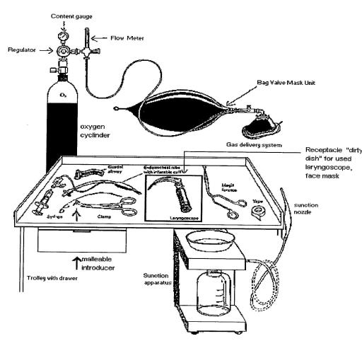
Equipment
Notes:
Oxygen
Bag valve mask
ETT – Size 7.5 or 80 for a male, 7.0 for a female
Laryngoscope
Syringe for cuff inflation
Lube
Cotton tape
Suction (yankeur and inline)
Magills forceps
Flexible introduce and/or Bougie
Resus trolley ‘just in case’
Identification of the location of the difficult airway trolley
(Practical play)- need intubation tray, BVM
Check all equipment prior to use – “tight and bright” laryngoscope, intact and lubed cuff on the ETT, cotton tapes cut and ready, ventilator settings, suction working.

Slide 6
Drugs
Notes:
Sedation – Before we paralyse, we must sedate!
Usually – Propofol (10mg/mL 200mg/20mL) or midazolam (5 in 5) and Fentanyl 200mcg
Paralysing agent – Suxamethonium 100mg/2mL (lasts 5-15mins) - Administration of suxamethonium causes an immediate rise in serum potassium – contraindicated in the hyperkalaemic patient.
Rocuronium 5mg/kg (50mg/5mL) – lasts up to 60mins!, Vecuronium – all rapid acting non-depolarisng neuromuscular blocking agents. (Watch for fasiculation – a muscle contraction and relaxtion)
Also handy to prepare some metaraminol in case of hypotension secondary to induction

Slide 7
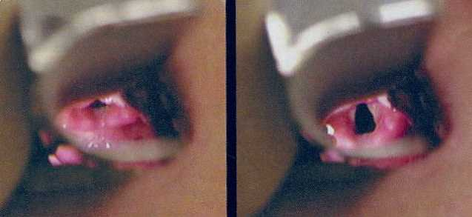
Down the Laryngoscope https://www.youtube.com/watch?v=tuvjEfEvlKo
Notes:
Looking through the laryngoscope to visualise the epiglottis and identify where the ETT will be going.

Slide 8
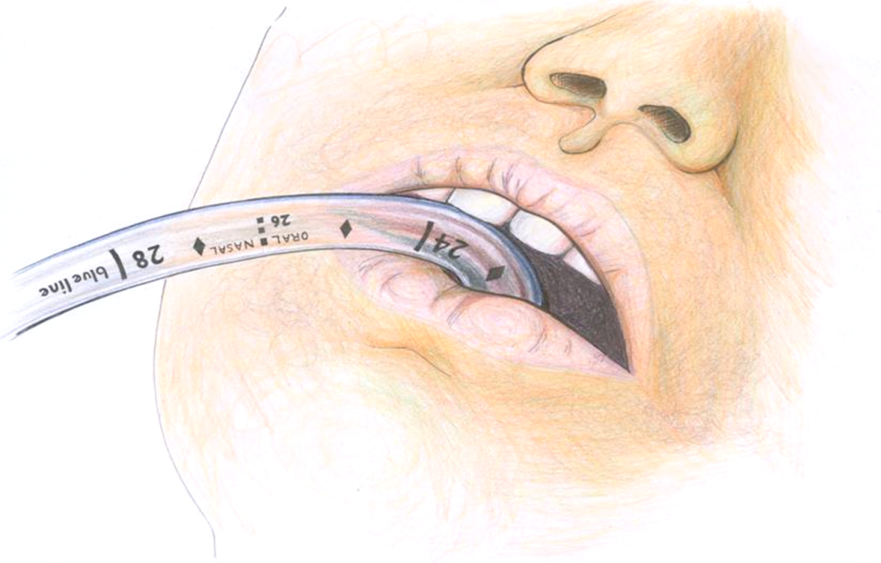
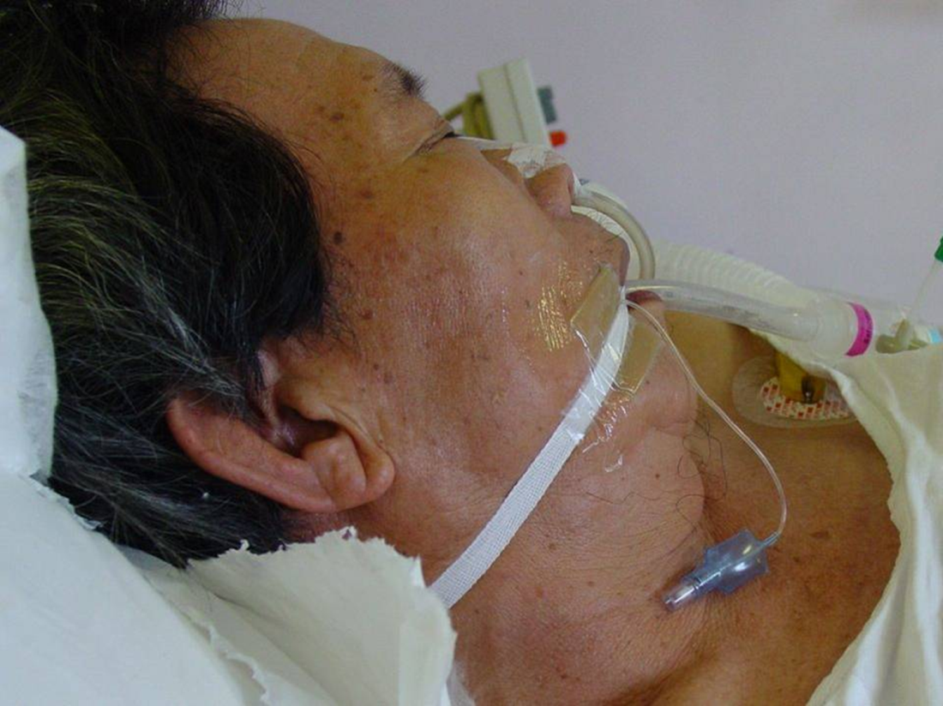
Secure it!
Notes:
Most male patients require the endotracheal tube to be tied at about 23 cm from the tip.
Most female patients require the endotracheal tube to be tied at about 21 cm from the tip.
Document on CIS, Call for Xray for confirmation
Talk about and do a practical application of anchorfast/white tapes/strappit

Slide 9
Be Prepared!
Risk of failure about 1-5%
Consequences of hypoxia potentially catastrophic
Notes:
LMA
Vasopressors

Slide 10
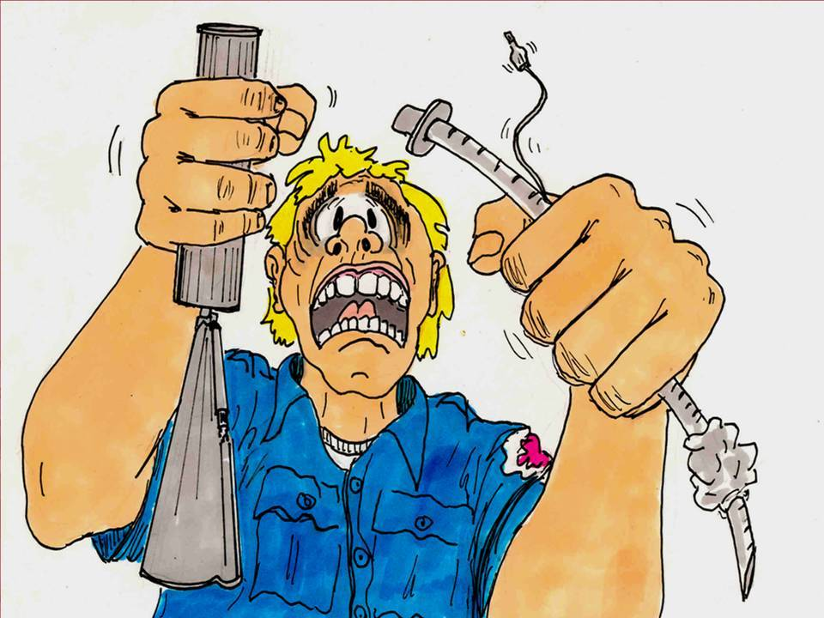
Questions?

