Slide 1
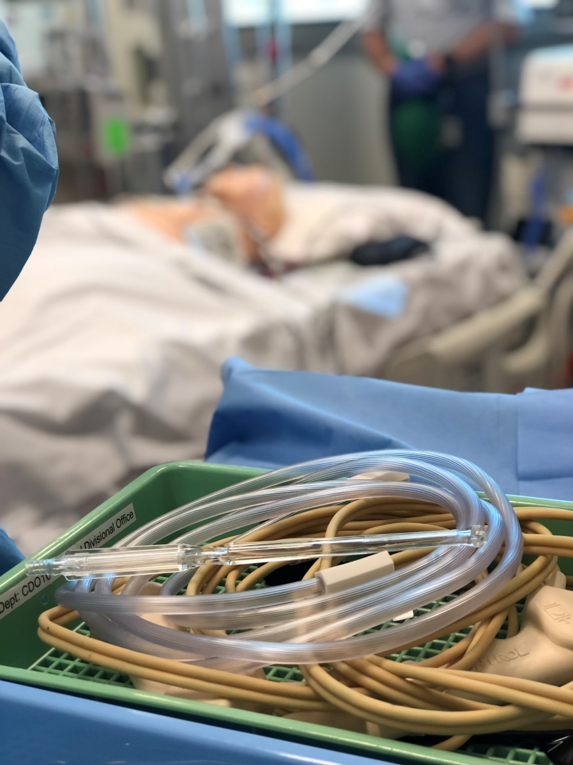
CALS

Slide 2
Objectives
To provide some information on the CALS Course
To highlights the differences in management between patients who arrest without having had cardiac surgery and those post CTS
To address emergency sternotomy in the ICU

Slide 3
CALS Course
The Cardiothoracic Advanced Life Support Australian and New Zealand (CALS ANZ) Provider Course is a face-to-face interdisciplinary learning opportunity which runs over one day.
It seeks to build knowledge, skills and confidence in the management of deteriorating patients following cardiac surgery, including the best-evidence based approach to cardiac arrest within ten days of sternotomy.

Slide 4
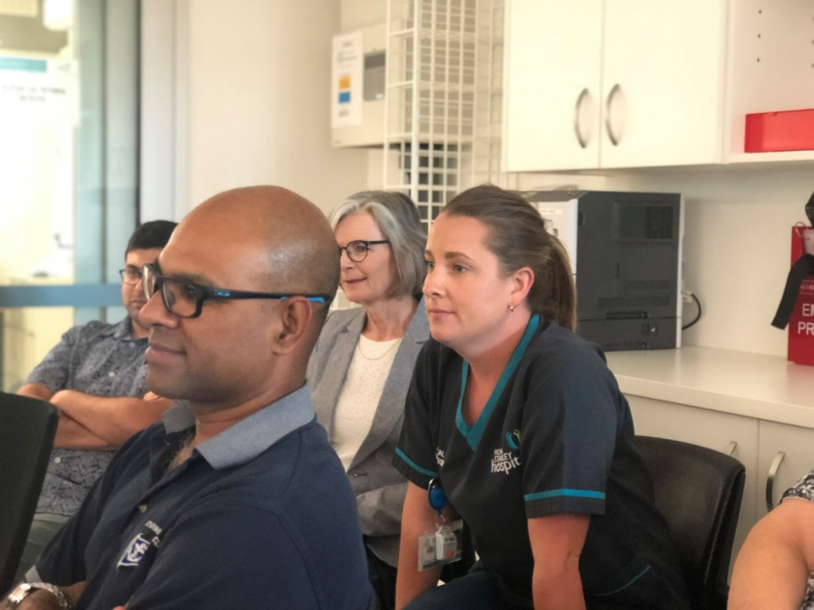
The course offers the following learning experiences:
An online pre-course e-learning package
Lectures
Scenarios
Simulations
Instructions for pre-course e-learning modules: https://www.calselearning.com/instructions/

Slide 5
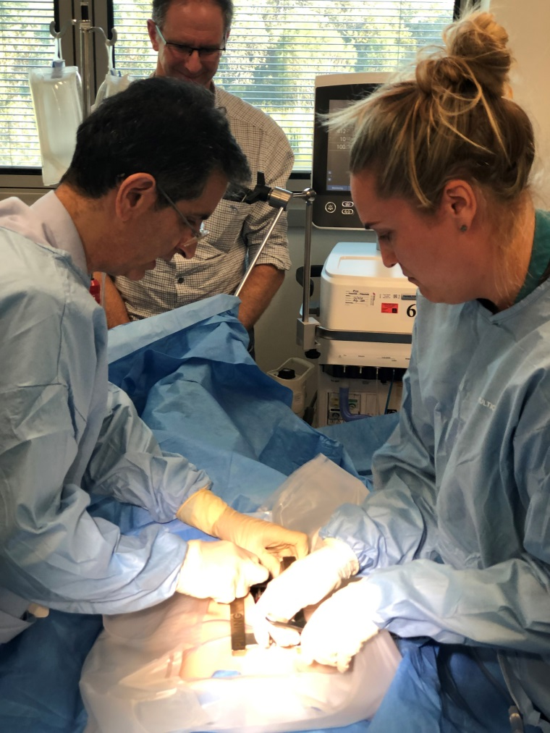
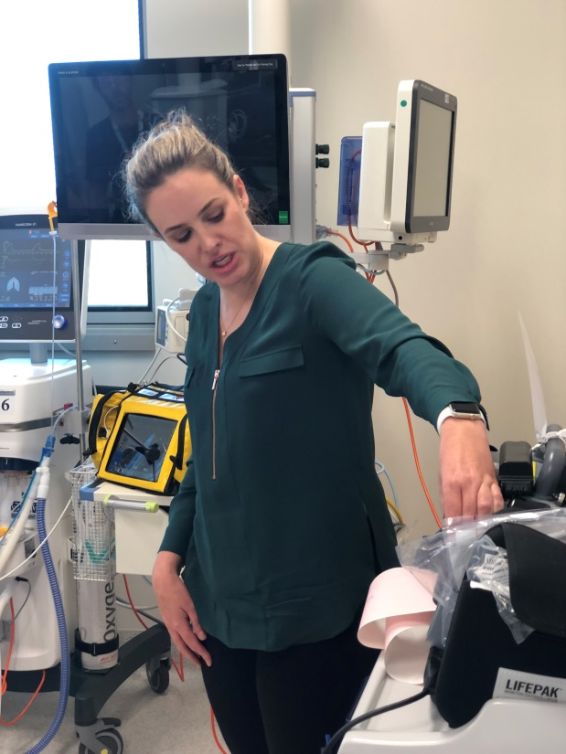
The skills stations and scenario based sessions are delivered to groups of no more than 10 people at a time. Four simulations occur at the end of the day. Attendees all participate in at least one simulation and watch the remaining ones.

Slide 6
Course content

Slide 7
Take-home message
Standard CPR is ineffective in:
Cardiac tamponade*
Profound hypovolaemia/bleeding*
Tension Pneumothorax
Without effective CPR – irreversible brain damage occurs within 5 minutes
Performing rapid (< 5 min) Emergency Resternotomy is essential to survival

Slide 8
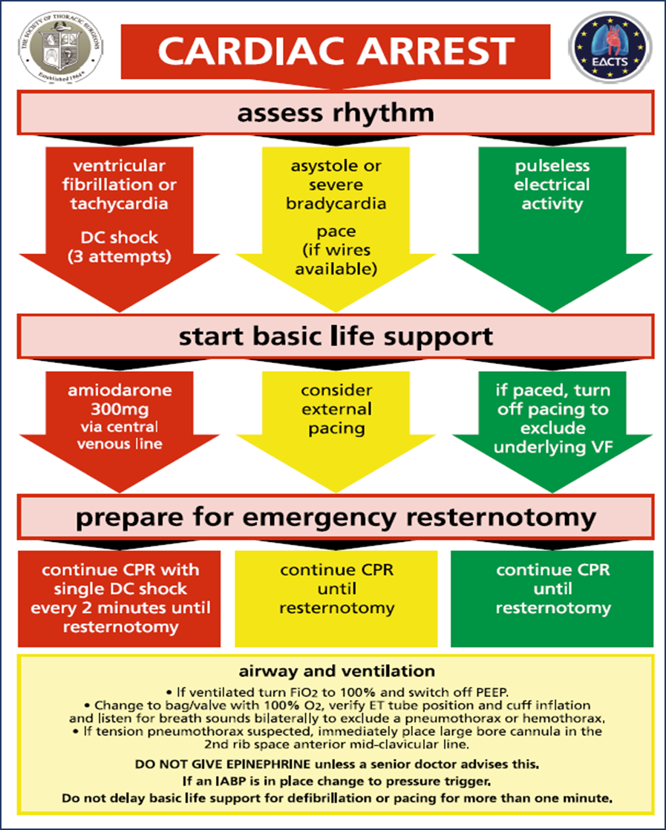

Slide 9
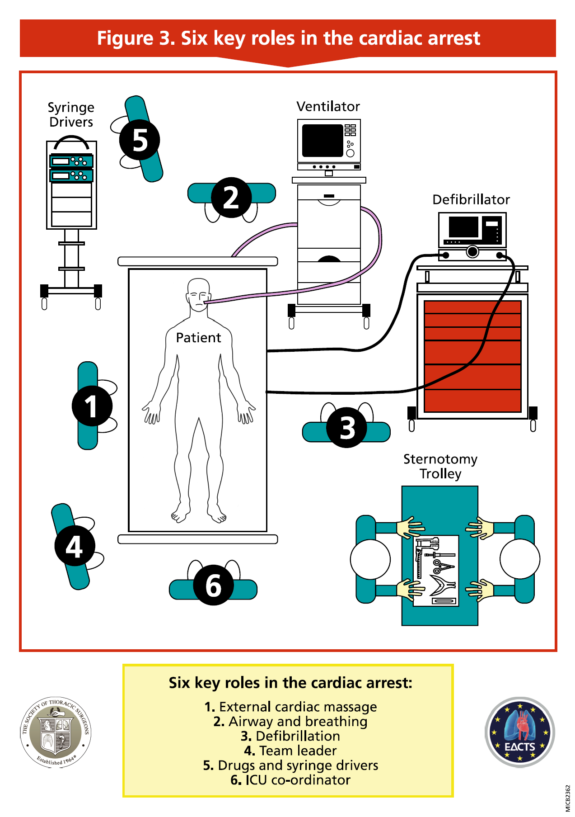

Slide 10
The STS/EACTS Resuscitation Protocol
2003: Two UK surgeons initiate project: J Dunning, A Levine
2004: First UK course in Manchester
2009: EACTS Guidelines: Resuscitation After Cardiac Surgery. Dunning J, Fabbri A, Koth PH, et al. Eur J Cardiothac Surg 2009;36:3-28.
2010: International Liaison Committee on Resuscitation and European resuscitation Council Guidelines. Nolan JP, et al. Resuscitation 2010;81:219-1276.
2015: STS Resuscitation Task Force initiated
2017: Publication of STS Consensus Statement. Dunning J, Levine A, Ley J, et al. Ann Thorac Surg, Feb 2017.

Slide 11
EACTS Guideline for Resuscitation After Cardiac Surgery
2009 – Guideline first published
2010 – Guideline adopted by ERC (equivalent to AHA)

Slide 12
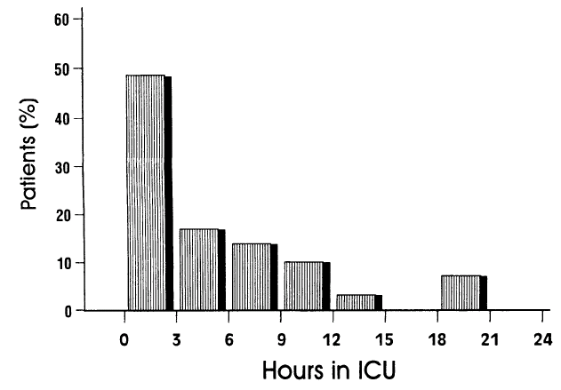
Q: When is cardiac arrest most likely to occur after heart surgery?
Incidence of unexpected cardiac arrest 29/3982 (0.7%)
50% occurred < 3 hours postop
84% occurred < 8 hours postop
Anthi A. Unexpected cardiac arrest after cardiac surgery. CHEST 1998; 113: 15-19.

Slide 13
Why is ACLS not recommended after Cardiothoracic Surgery?
ACLS – designed for out of hospital cardiac arrest
STS/EACTS protocol – designed specifically for CICU
Notes:
STS/EACTS protocol – designed specifically for CICU

Slide 14
Reopen Early for Survival
Papworth Hospital – 79 resternotomies / 6 years
Reopening within 10 minutes increased survival 4-fold from 12% to 48% Mackay JH, Powell SJ, Osgathorp J, Rozario CJ. EJCTS 2002.
Royal Brompton & Harefield – 72 resternotomies / 4 years
46% initial survival with 17% discharged; recommend resternotomy within 5 minutes of arrest Pottle A, Bullock I, Thomas J, Scott L, Resuscitation 2002.

Slide 15
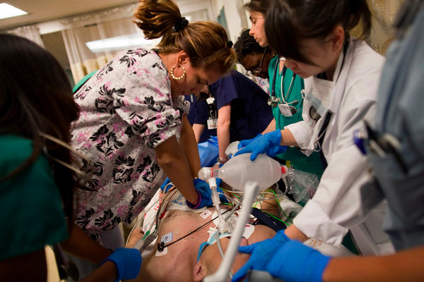
STS/EACTS Recommendation: External cardiac massage (ECM)
ACLS
Immediate ECM for all arrests
STS/EACTS
ECM is associated with potentially fatal complications
ECM may be unnecessary if the arrest is readily reversible with defibrillation or pacing
If the ECG shows VF/pVT or asystole you may delay external cardiac massage for up to one minute to administer shocks or to maximize pacing outputs, respectively

Slide 16
STS/EACTS Protocol vs ACLS
STS /EACTS Protocol | ACLS
For VF/pVT For VF/pVT
Defibrillation takes priority; may defer CPR for up to 1 minute | CPR should be performed immediately on all patients
3 successive shocks before CPR | CPR → 1 shock → CPR
For Asystole, PEA For Asystole, PEA
Dual chamber pacing, max output | CPR and Adrenaline
For VF/pVT, Asystole, PEA
No adren. unless by senior clinician; If used pre-arrest reduce dose | Adrenaline 1 mg every 3-5 minutes
Use 6 key roles in arrest; 2 sterile providers gown & glove | Similar roles and responsibilities

Slide 17
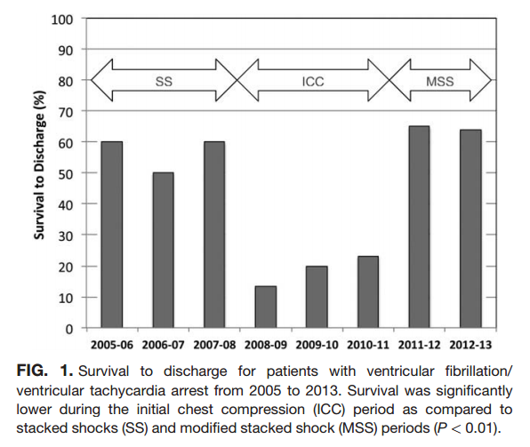
Two recent studies favour stacked shocks
Multicenter retrospective review of adults w/ IHCA from VF/pVT
Improved outcomes w/ rapid sequence shocks vs deferred 2nd shock
ROSC in 62.5% (1008/1612) vs 57.4% (643/1121; Risk Ratio 0.92)
Survival to discharge in 30.8% (495/1605) vs 24.7% (277/1121; RR 0.80)
Bradley SM, Liu W, Chan PS, et al. BMJ 2016; 353:i1653. doi:10:1136/bmj.i1653
Single center review of 3 historical protocols for resuscitation
3 stacked shocks → single shock & 2 min CPR → 3 SS (120J-150J-200J)
Worst survival with single shock
Highest survival after resuming 3 SS
Davis D, et al. J Hosp Med 2016;11(4):264-268
“Our data suggest that in cases of monitored VF/VT arrest, expeditious defibrillation with use of stacked shocks is associated with a higher rate of ROSC and survival to hospital discharge.”

Slide 18
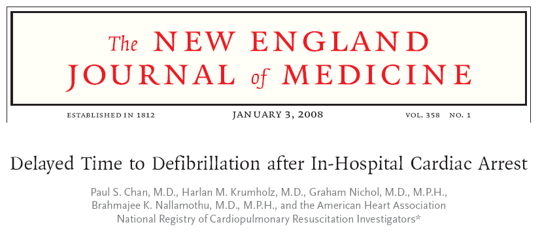
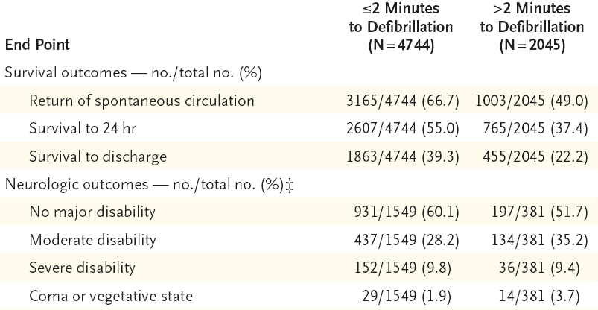
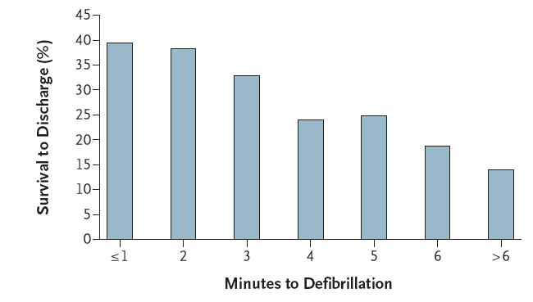
Q: What is the relationship between time to defibrillate and recovery?

Slide 19
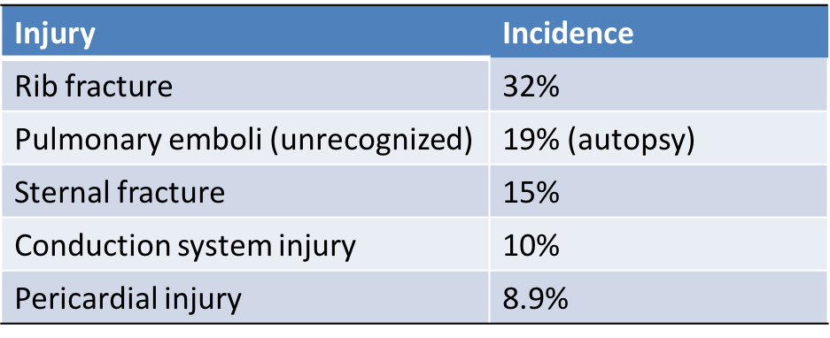
Q: What harm may be associated with CPR?
Meta-analysis (23 papers) where CPR was performed; injuries confirmed with autopsy or dedicated imaging assessment
Percentage of patients with post-CPR injuries: Standard CPR 32-45% vs active compression devices 58-75%
Additional case reports include myocardial laceration, chamber rupture, prosthetic valve dehiscence

Slide 20
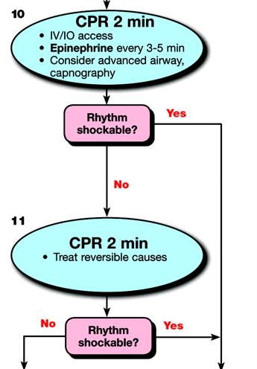
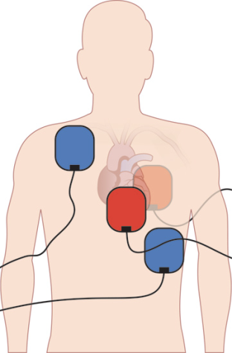
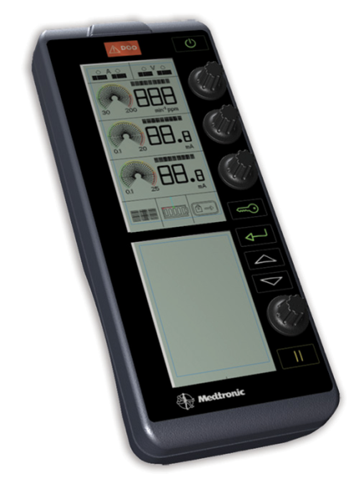
Q: How is asystole managed?
ACLS
STS/EACTS
External dual chamber pacing
Transcutaneous pacing
Emergency resternotomy

Slide 21
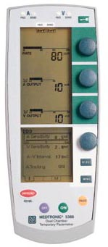
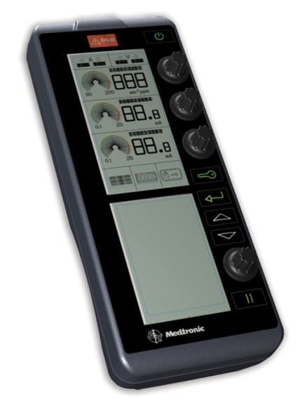
STS/EACTS Recommendation: Emergency pacing
For asystole or severe bradycardia: connect epicardial pacing wires, set to DDD at 80 -100 bpm, maximum atrial and ventricular outputs. Emergency pacing button may be used.

Slide 22
STS/EACTS Protocol vs ACLS
STS /EACTS Protocol | ACLS
For VF/pVT For VF/pVT
Defibrillation takes priority; may defer CPR for up to 1 minute | CPR should be performed immediately on all patients
3 successive shocks before CPR | CPR → 1 shock → CPR
For Asystole, PEA For Asystole, PEA
Dual chamber pacing, max output | CPR and Adrenaline
For VF/pVT, Asystole, PEA
No adren. unless by senior clinician; If used pre-arrest reduce dose | Adrenaline 1 mg every 3-5 minutes
Use 6 key roles in arrest; 2 sterile providers gown & glove | Similar roles and responsibilities

Slide 23
STS/EACTS Recommendation: Do not give adrenaline in cardiac arrest
Concern for destabilizing rebound hyper-tension
No study has demonstrated that adrenaline improves neurologic recovery or survival to discharge
Recent studies show worse outcomes if given for VF/pVT
Adrenaline may be beneficial for pending arrest in smaller doses (50-300 mcg boluses)
Neither adrenaline nor vasopressin should be given during the cardiac arrest unless directed by a clinician experienced in its use in cardiac surgery

Slide 24
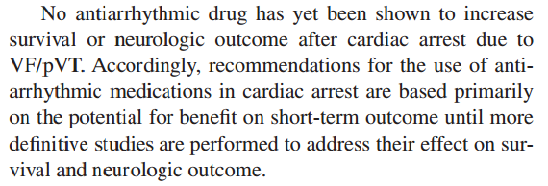
Adrenaline
Circulation 2015;132[suppl 2]:S444–S464.

Slide 25
STS/EACTS Protocol vs ACLS
STS /EACTS Protocol | ACLS
For VF/pVT For VF/pVT
Defibrillation takes priority; may defer CPR for up to 1 minute | CPR should be performed immediately on all patients
3 successive shocks before CPR | CPR → 1 shock → CPR
For Asystole, PEA For Asystole, PEA
Dual chamber pacing, max out | CPR and Adrenaline
For VF/pVT, Asystole, PEA
No adren. unless by senior clinician; If used pre-arrest reduce dose | Adrenaline 1 mg every 3-5 minutes
Use 6 key roles in arrest; 2 sterile providers gown & glove | Similar roles and responsibilities
Rapid resternotomy (<5 min) if no response to pacing or defibrillation | N/A

Slide 26
The Protocol for Emergency Resternotomy
Continue ECM until ready to drape
Remove dressing just before drape applied
2-3 providers don gown and glove
Prep, hat, mask not required if team prepared to open
Handwashing not required before donning gloves
Apply sterile drape ensuring whole bed is covered
Change should take < 10 seconds
1 person prepared to open/hand off sterile supplies
Small resternotomy set (5pc or designated)
Internal defib paddles; receive non-sterile end
Sterile suction; receive non-sterile end

Slide 27
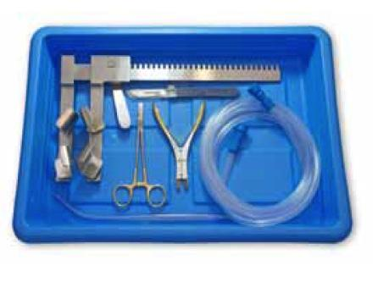
5-piece Resternotomy Set
Scalpel
Wire cutter
Wire puller
Retractor
Suction tubing/yankauer
Optional: scissor, forceps

Slide 28
Summary
Management of Arrest after Cardiac Surgery
Arrest management in ICU is an anticipated problem that requires teamwork and preparation
A modified approach is warranted based on the environment and population – superior outcomes are demonstrated with:
Immediate arrhythmia management – prior to ECM
Knowledge of protocol and key roles fostering timely emergency resternotomy
Removal of adrenaline from arrest algorithm

