Slide 1
Inotrope + Vasoactive Safety

Slide 3
Objectives
Define vasoactive and inotropic medications
Discuss commonly used medications
Outline the indications and contraindications
Discuss nursing management of vasoactive and inotropic medication

Slide 4
What are Vasoactives?
A pharmacological agent given intravenously to optimise cardiac output
Many of these also affect the peripheral circulation:
- Vasoconstrictors
- Vasodilators

Slide 5
Main Goal
Tissue Perfusion
Oxygenation

Slide 6
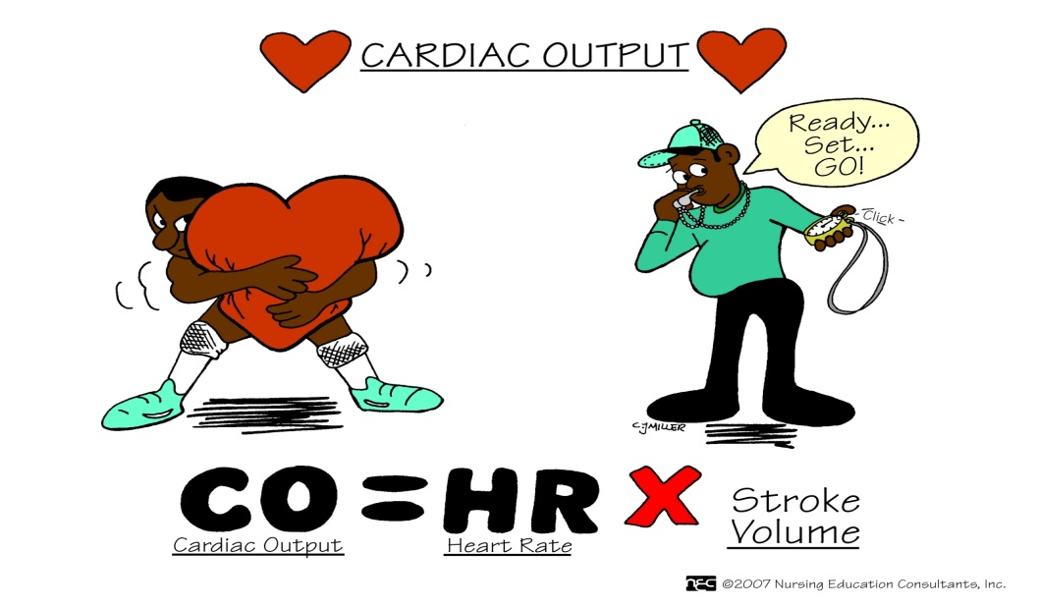
Definition of Terms
Cardiac Output:
The amount of blood ejected from the heart in litres/minute

Slide 7
Definition of Terms
Preload
The volume of blood in the ventricle at the end of diastole.
Afterload
Resistance the heart must pump against to eject blood out of the ventricles.
Contractility
Ability of the muscle fibres to contract in order to eject blood into the circulation

Slide 8
Definition of Terms
Inotrope: Can be positive or negative
↑ the force of the contraction
↑ SV
Chronotrope : Can be positive or negative
↑ HR (↑ firing rate of SA node)
Dromotrope :
↑ speed of conduction through the AV node
Notes:
Inotrope +ve = Dobutamine –ve betablockers
Chronotrope +ve atropine/ isoprenalin –ve betablockers/digoxin
Dromotrope +ve catacholamines –ve calcium channel blockers. Adenosine

Slide 9
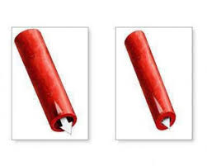
Definition of Terms
Lusotrope:
↑ relaxation in diastole,
↓ end-diastolic pressure in ventricles
Vasopressor:
drugs that stimulate smooth muscle contraction of the capillaries & arteries
elevate Mean Arterial Pressure (MAP) by inducing vasoconstriction
↑ SVR, ↑ BP
Notes:
Lusotrope –
Vasopressor – +ve adrenalin, noradnenalin, metaraminol
-ve GTN/ SNP

Slide 10
Receptor Physiology
Vasoactives affect different receptor sites within the body
3 main types:
Alpha
Beta 1
Beta 2
Notes:
Alpha – Located on the arterioles. When the alpha receptors are stimulated the arterioles contract. This increases the blood flow returning to the heart.
Beta 1 – located in the heart, when Beta 1 receptors are stimulated they increase the HR and increase the heart’s strength of contraction or contractility.
Beta 2 – located in the bronchioles of the lungs and the arterioles of the skeletal system. When these receptors are stimulated they increase the diameter of the bronchioles to let more air in and out during breathing and they dilate the vessels of the skeletal muscles so they can receive the increase in blood flow produced by the alpha and beta 1 receptors.

Slide 11
Receptor Physiology

Slide 12
Clinical Use
Shock
Septic
Cardiogenic
Hypovolemic
Symptomatic heart failure
Post cardiac surgery
Bradyarrhythmias
Rt Ventricular Infarction
Cardio-pulmonary arrest
Acute Kidney Injury (limited study)

Slide 13
Pre-Vasoactive Therapy
Before using inotropes, always ensure that the patient is adequately filled
CVP, PCWP are guides only
Note trends rather than individual numbers
Consider left or right heart failure when interpreting the numbers

Slide 14
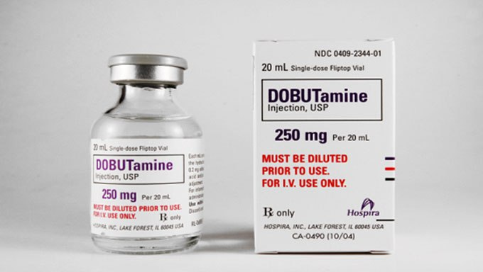
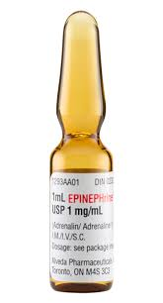
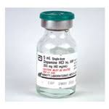
Types of Drugs

Slide 15
Adrenaline
Acts on both Alpha and Beta receptors
↑ CO, ↑ SBP/MAP
Positive inotrope, chronotrope and dromotrope
Relaxes bronchial spasm
Mobilises liver glycogen (↑BSL)
Rapid onset, short duration
Metabolized by liver
Standard infusion
6 mg in 100 ml of 5% Dextrose or N/Saline
Double and quad strength if appropriate
Use in cardiac arrest – 1mg Boluses

Slide 16
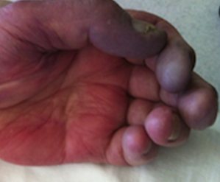
Noradrenaline
Binds primarily to Alpha receptors but also has some Beta effects
Marked peripheral vasoconstrictor
Used mainly for its vasoconstriction effects in shock
Monitor peripheral perfusion
Standard Infusion
8mg in 100 ml 5% Dextrose
Double and quad strength if appropriate
Titrate infusion to effect & MAP parameters
Rate capping issues at high dose (futility/efficacy)
DO NOT BOLUS!

Slide 17
Metaraminol
Binds primarily to Alpha receptors but also has some Beta effects
Marked peripheral vasoconstriction
Its effects commence 1-2 minutes after IV injection and last 20mins to 1 hour
Standard infusion
- 10mg/20mls (bolus)
- 20mg/40mls (infusion)
Can be used peripherally

Slide 18
Dopamine
Can stimulate Alpha and Beta receptors
Dependant on dose
Metabolised in liver & kidneys
Excreted by kidneys
Standard dilution:
200mg/100mls 5% Dextrose (Central)
200mg/500mls 5% Dextrose (Peripheral)
Low dose 0.5 – 2 mcg/kg/min
Renal vasodilation - controversial
2-10 mcg/kg/min -ß1 positive inotropic, chronotropic, and dromotropic effects
>10 mcg/kg/min - peripheral vasoconstriction

Slide 19
Dobutamine
Has a mix of effects Beta 1 & Beta 2
Acts as a +ve inotrope through stimulation of ß1 receptors, with comparatively small chronotropic properties
=> No ↑ in HR, but big ↑ in SV
Mainly used in Cardiogenic shock
Higher doses may cause vasoconstriction due to the alpha effects on the blood vessels.
Dosage: 0.5 – 2 mcg/kg/min and be titrated up to 20 mcg/kg/min
Minimal effect on myocardial oxygen demand
Standard mixture
500mg in 100ml of 5% Dextrose
Notes:
Beta 1 stimulation causes increase in contractility
Beta 2 peripheral vasodilation

Slide 20
Vasoactive Medication Receptor Activity and Clinical Effects
DRUG | Alpha 1 | Beta 1 | Beta 2 | Clinical Effects
Phenylephrine | +++ | 0 | 0 | SVR ↑↑ CO ↔∕↑
Noradrenaline | +++ | ++ | 0 | SVR ↑↑ CO ↔∕↑
Adrenaline | +++ | +++ | ++ | SVR ↑↑ CO ↔∕↑
Metaraminol | +++ | + | 0 | SVR ↑↑ CO ↔∕↑
Dopamine (mcg/Kg/min)
0.5-2 | 0 | + | 0 | Renal Vasodilation
5 - 10 | + | ++ | 0 | SVR ↓, CO ↑
10 - 20 | ++ | ++ | 0 | SVR ↑↑
Dobutamine | 0/+ | +++ | ++ | SVR ↓, CO ↑

Slide 21
Complications
Usually dose/drug related
Arrhythmias
Hypertension
Some inotropes ↑ myocardial oxygen demand → increased risk of ischemia
Given via a central line to reduce risk of extravasation
Some inotropes ↑ risk of renal failure > renal vasoconstriction
Increased blood sugar level

Slide 22
Practical Considerations
Vascular access
Access to medication
Compatibilities
Change over of lines
Titration parameters
ceiling of care
Adverse effects

Slide 23
Safety Issues
Review FSH Nursing Practice Standard
Central access always preferred
Peripheral Line
Must flush well
As big as possible
Preferred infusion site = forearm (basilic, cephalic, and median antebrachial)
Caution with dorsum of hand, wrist, feet
Convert to central access as soon as possible

Slide 24
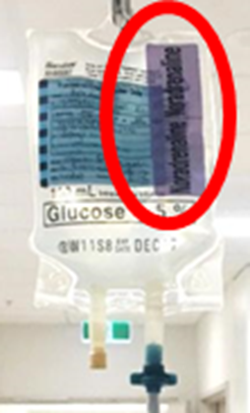
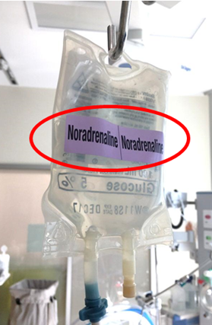
Safety Considerations
Preparation of bag
Ensure 6 rights of medication administration are completed throughout the process
Remove and discard volume of additive from diluent
eg. if inserting 8mL of noradrenaline into a 100mL bag of 5% Dextrose, first remove and discard 8mL of dextrose from the bag
Inject vasoactive onto diluent bag
Complete and attach standard blue IV additive sticker to front of bag
Attach vasoactive medication name label (pink sticker) to front and back of bag

Slide 25
Safety Considerations
If continuing a current infusion,
immediately hang the new bag on the hook behind, behind the current infusion running. No infusions are to be left sitting at a workspace.
the 6 rights of medication administration must be re-checked immediately prior to commencing new bag
If the bag is for a new infusion, proceed to prepare the IV line

Slide 26
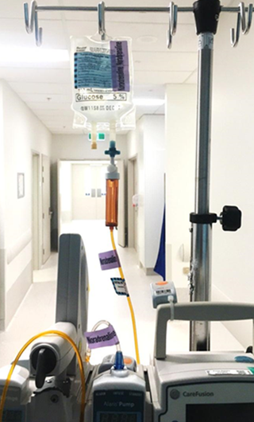
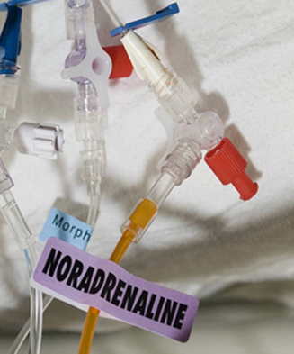
Safety Considerations

Slide 27
Safety Considerations
Preparation of pump
Ensure ‘Adult Critical Care’ profile is selected
Select vasoactive medication being delivered
Program 80% of bag volume as the VTBI
eg. If using 100mL bag, select 80mL as the VTBI
Be aware of the drug concentration
When VTBI has been achieved, pump rate drops to 20mL/hour, regardless of the rate that is programmed. If rate exceeds 20mL/hour, change concentration to double or quad strength
Choose lumen (consider drug compatibilities)
Second nurse must check programming of pump, and connection to patient

Slide 28
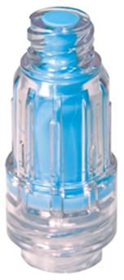
Safety Considerations
Weaning
Wean therapy slowly, titrate rate in mcg/kg/min
Continuous monitoring of hemodynamic status and tolerance to process is required
Disconnection
Any vasoactive infusions that have been weaned off
CVC port clamp must be engaged & 3 way tap closed to patient
Infusion must not remain connected to the patient for > 1 hour
After this time, disconnect infusion and discard
If the lumen has no other infusions running through it, aspirate and flush with 0.9% NaCl to preserve patency
Attach positive- pressure bung to CVL
If unable to aspirate port- DO NOT FLUSH!
Label line as “Do Not Use” & document in notes. Engage blue clamp on CVL lumen. Cap lumen with a ‘red’ bung.

Slide 29
Safety Checks
Access
Secure
Adequate
Emergency access?
Line free of kinks, air bubbles
Ensure monitoring alarms are active, with appropriate limits
Invasive haemodynamic monitoring accurate
Zero, level transducers

Slide 30
Conclusion
Always practice as per the FSH NPS, and refer to the specific drug guidelines
A sound knowledge of the effects and potential complications of vasoactives/inotropic drugs are essential
Awareness of safety precautions will help to prevent complications related to inotrope infusions
Peripheral IV administration should only be used in extreme circumstances

Slide 31
Practical

