Slide 1
Severe Sepsis & Septic Shock

Slide 2
Severe sepsis & septic shock
Leading cause of death in ICUs
New definitions for sepsis and septic shock
JAMA 2016;315(8):801-810
To offer greater consistency for epidemiological studies and clinical trials, and facilitate earlier recognition and more timely management of patients with sepsis or at risk of developing sepsis

Slide 3
Sepsis
Life-threatening organ dysfunction caused by a dysregulated host response to infection.
Organ dysfunction represented by an increase in the Sequential Organ Failure Assessment(SOFA) score by 2 points or more, which is associated with an in-hospital mortality of greater than 10%

Slide 4
Septic Shock
Septic shock should be defined as a subset of sepsis in which particularly profound circulatory, cellular and metabolic abnormalities are associated with a greater risk of mortality than sepsis alone.
Clinically identified by a vasopressor requirement to maintain a MAP of 65mmHg or greater and a lactate level of greater than 2mmol/L in the absence of hypovolaemia.
Associated with an in-hospital mortality of greater than 40%.

Slide 5
Septic Shock
The presence of bacterial endotoxin causes the release of inflammatory cytokines ( TNF and IL-1) from monocytes and macrophages.
These cytokines cause an inflammatory cascade with release of more cytokines which affects many organ systems including:
Temperature set point
Vascular resistance and permeability
Cardiac function (depressant effect)
Bone marrow effects (leukocytosis)
Enzymes and hormones which alter cellular metabolism
Activation of the complement, coagulation and kinin systems

Slide 6
Cascade of Injury
Bacterial Products
and Components
↑ Coagulation
↑ Complement
↑ Tissue Factor
↓ Fibrinolysis
↑ Cytokines
↑ PAF
Macrophage
Platelet
Activation
↑ Thromboxane A₂
↑ PGS, LTS
T-Cell Release
of IL-2,
INF-g,
GM-CSF
↑ Neutrophils activation
↑ O₂ radicals
↑ Proteases
Endothelial Damage
Tissue Injury
Organ Dysfunction
Adapted from Bone RC. Ann Intern Med. 1991;115:457-469

Slide 7
Stages of Shock
Compensated stage – in which normal circulatory compensatory mechanisms act to prevent tissue damage allowing full recovery provided the primary problem is corrected
Progressive stage - shock progresses to tissue injury and without therapy, to death
Irreversible stage – shock has progressed to an extent that death is inevitable despite all available therapy

Slide 8
Clinical manifestations
Compensated shock
Subtle signs only:
tachycardia, cool peripheries, oliguria,
Shock can be present with a normal BP
Progressive Shock
Tachycardia, dyspnoea, hypotension, altered mental state, diaphoretic, oliguric to anuric, cool and clammy skin, ↑lactic acidosis
Irreversible Shock
Frank organ dysfunction: severe hypotension (despite inotropic and vasopressor support), refractory lactic acidosis (despite maximal support), coma and death

Slide 9
Management principles
Early treatment
Rapid identification of source of sepsis
Early source control
Early, appropriate antibiotics
Notes:
Delay in administration of antibiotics or administration of inappropriate antibiotics results in worse outcome

Slide 10
Management Principles
Adjunctive treatment
Corticosteroids
Glucose control
Organ support
Mechanical ventilation
Renal Replacement Therapy

Slide 11
Management Principles
Other supportive therapy
Stress ulcer prophylaxis
Adequate nutrition
DVT prophylaxis

Slide 12
The Golden Hour
Initial history & examination
Resuscitate
Further history & examination
1 hour
Investigations
Microbiological specimens
Antibiotics
Notes:
Need to work rapidly to achieve this. Aim is to administer antibiotics within 1 hour. In this time the patient has to be resuscitated, a diagnosis made and microbiological specimens taken so it is a group effort.

Slide 13
Therapeutic goals in resuscitation
Early goal-directed in the treatment of severe sepsis and septic shock
Rivers et al NEJM 2001 345:1368-1377
ARISE(Australasian resuscitation in sepsis evaluation), ProCESS (protocolized care for early septic shock-USA), ProMISe (protocolised management in sepsis - UK) Trials
2014 – 2015
No survival advantage

Slide 14
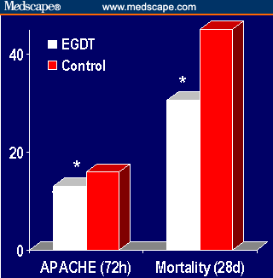
EGDT - results
13±6.3 15.9±6.4 30.5% 46.5%
P<0.001 P=0.009
Notes:
263 patients. Therapy group has less severe organ failure at 72 hours and lower mortality at 28 days.

Slide 15
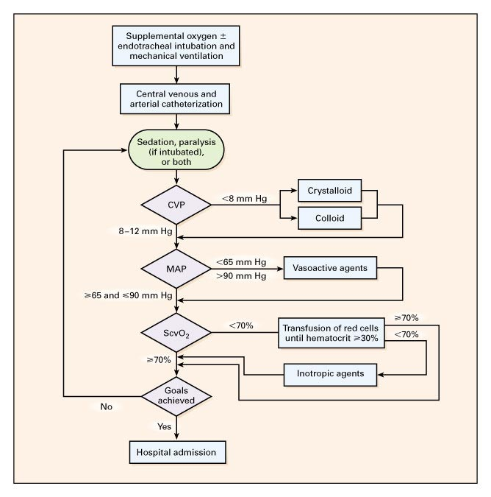
Protocol for Early Goal-Directed Therapy
Rivers E et al. N Engl J Med 2001;345:1368-1377
Notes:
Figure 2. Protocol for Early Goal-Directed Therapy. CVP denotes central venous pressure, MAP mean arterial pressure, and ScvO2 central venous oxygen saturation. These are the targets recommended by the international guidelines for treating sepsis and septic shock.

Slide 16
Basic Principle in the Management of Shock
Shock is inadequate tissue oxygenation
Treatment is thus to restore tissue oxygen delivery DO2
Notes:
The management of shock

Slide 17
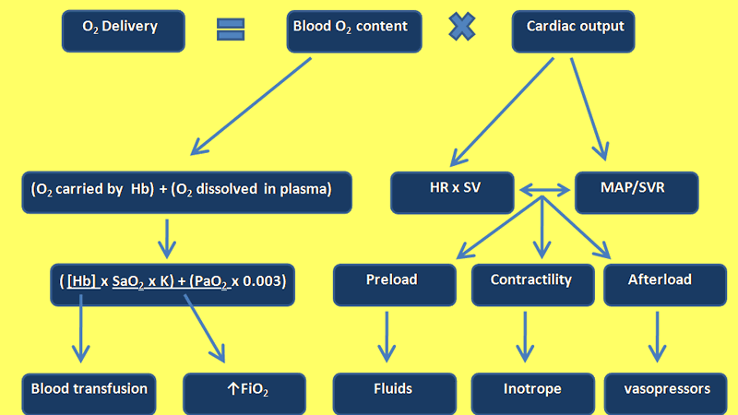
Basic principles for the Management of shock

Slide 18
Resuscitate
Fluid resuscitate
Fluid challenges
500-1000 ml crystalloid over 30 mins
300-500 colloid (Albumin is recommended)
Titrate against response (BP & tissue perfusion) and adverse effects
Notes:
Crystalloid or colloid solutions can be used for fluid resuscitation. Neither type of fluid has been shown to be superior to the other. Give fluid challenges of 300-500 ml of colloid or 500-1000 ml of crystalloid rapidly, repeated as necessary, based on response (blood pressure and signs of tissue perfusion) and tolerance (signs of intravascular fluid overload). The fluid input-output balance is of no value in assessing fluid requirements during the first 24 hours because of the capillary leak that characterizes sepsis.

Slide 19
Fluid resuscitation
Goals (recommendations from the Surviving Sepsis Campaign guidelines 2008):
CVP 8 – 12 mmHg
MAP ≥ 65 mmHg
UO ≥ 0.5 mls/kg
Venous sat (CVP) ≥ 70% or SvO2 ≥ 65%. If targets not achieved, consider further therapy
Give RBC if HCT ≤ 30% if there was history of IHD. Hypoxia, persisting lactic acidosis

Slide 20
Fluid resuscitation
Guides for optimal fluid resuscitation:
Peripheral perfusion
LV size, IVC diameter (ECHO)
PAOP and CO (PAC)
Lactate
PPV/SVV in ventilated patients

Slide 21
Principles of fluid resuscitation
Give the right amount of fluid
Excessive fluid is not without harm
Tissue oedema exacerbating tissue hypoxia
Pulmonary oedema/ARDS
Abdominal compartment syndrome
Worsening cardiac function due to ↓ ventricular compliance
↑ mortality [CCM 2011 39(2):259-265]

Slide 22
Other considerations in fluid resuscitation
What type of fluid
Crystalloid – N/S, Hartmann, 5% Dext
Colloid – Albumin, Gelatins, Starch
Blood
Notes:
Not 5% Dextrose. Colloid stays intravascular so may be more effective for longer. Blood expand vascular volume and can improve O2 carrying capacity

Slide 23
Fluid types - Theoretical considerations
2 – 3x more crystalloid required compared to colloid for same resuscitation end point, less volume may translate to less oedema
Hyperchloraemic acidosis with large quantities of saline
Lactate load with Hartmann’s, hyperkalaemia may also be problematic
Albumin may bind endotoxin and act as antioxidant
Starch preparations predispose to renal dysfunction. Can cause von Willibrand type clotting abnormality (CHEST NEJM)
Anaphylactic and anaphylactoid reactions with colloid and albumin
Notes:
Many conflicting but crystalloid is cheap, safe and readily available

Slide 24
SAFE (Saline Vs Albumin Fluid Evaluation)
Largest prospective double blinded randomized controlled trail comparing N/Saline and 4% albumin
7000 patients
No overall difference in mortality at 28 days
Some mortality differences (not significant but numbers smaller) found in subgroup analysis

Slide 25
Fluid types
There is no evidence based support for any one type of fluid
SAFE study subgroup analysis:
Albumin may be deleterious in the head injured
Septic patients in the albumin arm - trend of ⬇ mortality
Recommendation:
Crystalloid should form the basis for initial fluid resuscitation and maintenance with consideration of colloid/albumin for fluid challenges
Choice of fluid must be individualized taking patient circumstances (diagnosis, oxygenation, albumin, oedema) and cost into consideration

Slide 26
Fluid Type
CHEST
Saline vs HES 6% (Voluven):
7000 ICU patients
No difference in mortality
More RRT required in HES group
Do not use HES

Slide 27
Blood transfusion in ICU
RBC transfusion MAY ⬆ DO2 BUT
Previous studies showed transfusion to be harmful
Risks of RBC transfusion
Infection
Immunosuppression
Pro-inflammatory
⬆ PVR
Depletes NO stores ➔ regional and systemic vasoconstriction

Slide 28
Blood transfusion in shock
TRICC (NEJM 1999; 340:409-417):
838 ICU patients
Liberal (transfuse < 10), restrictive (transfuse < 7)
No difference in ICU mortality between groups
Significant ⬆ mortality in:
APACHE ≤ 20
Age < 55 (apart from those with IHD)
Significant ⬇ in hospital mortality in the restrictive group

Slide 29
Blood transfusion in shock
Anaemia and blood transfusion in a SICU (Critical Care 2010, 14;R92):
5925 pts with 1833 received RBC transfusion (Prospective, 50 bed SICU)
Lower Hb associated with:
⬆ SAPS and SOFA
⬆ overall mortality
⬆ Hospital and ICU LOS
Multivariable analysis showed no difference in ICU and hospital mortality between transfused and non-transfused pts
⬇ mortality in patients with higher Hb and those transfused after adjusting for confounders esp. in:
1. Age > 66 2. non-cardiac surgery 3. ⬆ severity scores 4. sepsis

Slide 30
Blood transfusion in shock
My practice:
In young stable patients with no evidence of tissue hypoxia – transfuse if < 7 g/dl
In patients with IHD, keep Hb ~ 9 – 10 g/dl
In patients with persistent inotrope requirement or hypoxia (ARDS) or tissue hypoxia, transfuse if < 8 g/dl

Slide 31
Resuscitate
Vasopressors
Indications:
Hypotension not responsive to fluid
Life threatening hypotension
Agents:
Norepinephrine (1st line)
Vasopressin (0.03 units/min)
Dobutamine
Tissue hypoperfusion despite adequate fluid resuscitation and blood pressure
Notes:
If hypotension does not respond to fluid vasopressors should be started. In life threatening hypotension it may be necessary to start vasopressors before the patient has been adequately fluid resuscitated in order to keep the patient alive. Never use vasopressin in patients who are cold and shut down. If warm and dilted and on large doses of NA then vasopressin should be considered Dobutamine improves cardiac contractility and is useful in patients with known poor LV function and in those with depressed LV function due to sepsis

Slide 32
Likely sources of sepsis
Chest
Intra-abdominal
Urinary tract infection
Notes:
Other sites: nervous system, soft tissue, sinuses, intravascular catheters

Slide 33
Investigations
Microbiology
Blood cultures
2 sets
Strict asepsis
20 ml blood sample
Urine specimen
Other cultures depending on clinical features
Notes:
Yield from two sets of blood cultures markedly greater than yield from one set. Strict asepsis important, otherwise significance of positive cultures difficult to interpret.

Slide 34
Treatment
Antibiotics
Early
Initially cover all likely organisms
Local flora and sensitivity patterns
Inadequate is a/c increased mortality
After appropriate microbiological specimens have been taken
Should be administered within first hour after diagnosis of sepsis
Notes:
Give antibiotics early based on a best guess. This should be informed by knowledge of local flora and sensitivity patterns.
NB antibiotics need only be delayed for appropriate specimens. Not necessary to wait for sputum in community acquired pneumonia or CSF in community acquired meningitis

Slide 35
Likely organisms
Source
Environment
Community
Healthcare facility
Intensive Care
Local factors
Patient factors
Co-existing illness
Previous antibiotics
Immunosuppression
Notes:
The likely organisms will depend on the site of infection, the environment in which the patient developed the infection and patient factors. When considering the environment in which the patient developed the infection it is vital to understand that local factors are of huge importance. The flora and sensitivity patterns differ from country to country, from hospital to hospital within a country and from ICU to ICU within a hospital.

Slide 36
Antibiotics
Penetration
Aminoglycosides and glycopeptides have relatively poor tissue penetration
Most agents have poor CNS penetration unless meninges inflammed
Adverse effects
Consult microbiologist if necessary
Notes:
Also take into account tissue penetration and adverse effect profile. Importance of adverse event profile will depend on which organs are failing

Slide 37
Antibiotics
Dual therapy
Pseudomonas aeruginosa
Enterobacter
Stenotrophomonas maltophilia

Slide 38
Antibiotics
Re-assess
Clinical response
Microbiological results
Aim to use narrower spectrum
Notes:
After starting antibiotics it is vital to assess the clinical response to antibiotics and to revise the antibiotics based on microbiological results with the aim of using a narrower spectrum

Slide 39
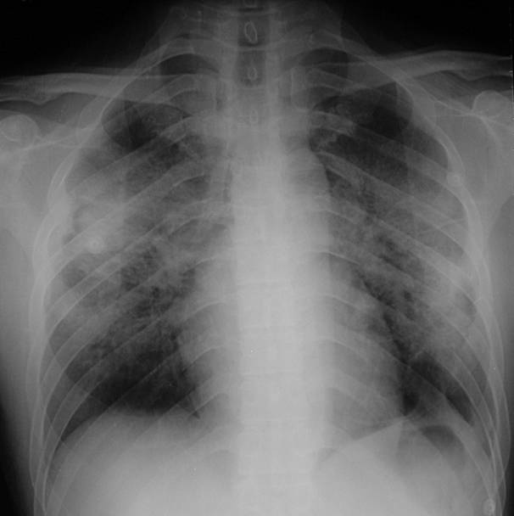
Notes:
Changes may be due to acute lung injury rather than pneumonia

Slide 40
Investigations
Other radiological investigations depending on history and examination
Notes:
History of recent bowel surgery makes intra-abdominal infection more likely. Useful radiology includes AXR, US and CT

Slide 41
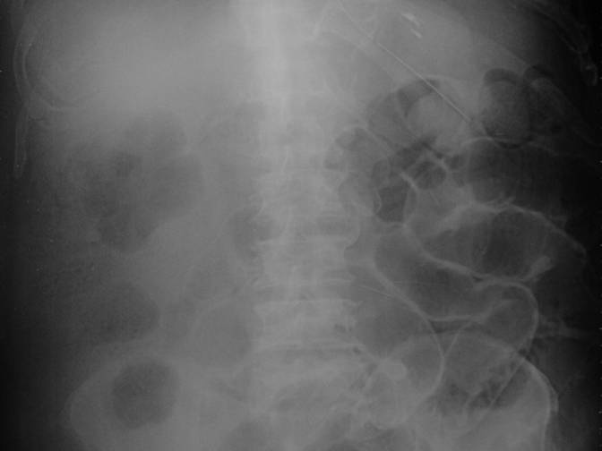
Notes:
Both inner and outer surfaces of bowel wall clearly seen indicating pneumoperitoneum

Slide 42
Treatment
Assess every patient for a source of infection that is amenable to source control measure

Slide 43
Treatment
Source control
Percutaneous or open drainage
Excision
Debridement
Removal of potentially infected devices
Notes:
In general use method of source control that results in the least physiological disturbance. Thus radiological percutaneous drainage of an abscess, if feasible, is preferable to open surgical drainage

Slide 44
Adjunctive Therapy
Corticosteroids
Corticus:
No difference in mortality between hydrocortisone and placebo group
Faster reversal of shock but more episodes of sepsis in steroid group
It is used in refractory septic shock

Slide 45
Adjunctive Therapy
Glucose control
Hyperglycaemia depresses WBC function
Hypoglycaemia is a/c with  mortality
Target BSL 6-10 mmol is recommended

Slide 46
Summary
Early recognition
Early resuscitation
Early identification of source
Early appropriate antibiotics
Early source control

Slide 47
Questions

